Slide 1

Wireless Networking
Ambuj Varshney
ambujv@nus.edu.sg
Notes:
++ Thank you for inviting me to give this talk
++ In this talk, I will present a pathway that can enable us to make wireless embedded systems ubiquitous. I will describe my previous research efforts that tackle the critical challenges that limit the growth of wireless embedded systems. These are related to the growing energy asymmetry that exists between sensing, computation and communication blocks on these platforms.
++ Finally, I will conclude my talk by covering the research agenda that I would like to work on as a faculty member.

Slide 2
Wireless and Internet of Things Basics
Notes:
++ Over the past few years, I have designed several backscatter and beyond backscatter systems that precisely overcome these critical challenges that have limited the widespread deployment of backscatter on IoT devices.
++ The research vision that I have pursued and would like to pursue as a faculty member is to enable a massive deployment of IoT devices by bridging the energy asymmetry between sensing, computation and communication blocks by designing novel platforms and communication mechanisms. I am going to describe some of my research contributions next.

Slide 3
Roadmap of the lecture today
Let us get to know the instructor ☺
What is this course about? Logistics? Grading Criteria?
Introduction to Embedded Systems (aka IoT)
Mark Weiser Vision for Ubiquitous Computing
Basics of Wireless Communication and Signal Propagation
Notes:
Here is the roadmap of the major topics that I am going to cover during the presentation. We have already covered the exponential growth of the internet of things; next, I will talk about the critical energy challenge that can severely hinder this massive growth and preventing us from realising this immense economic value enabled by the IoT.

Slide 4
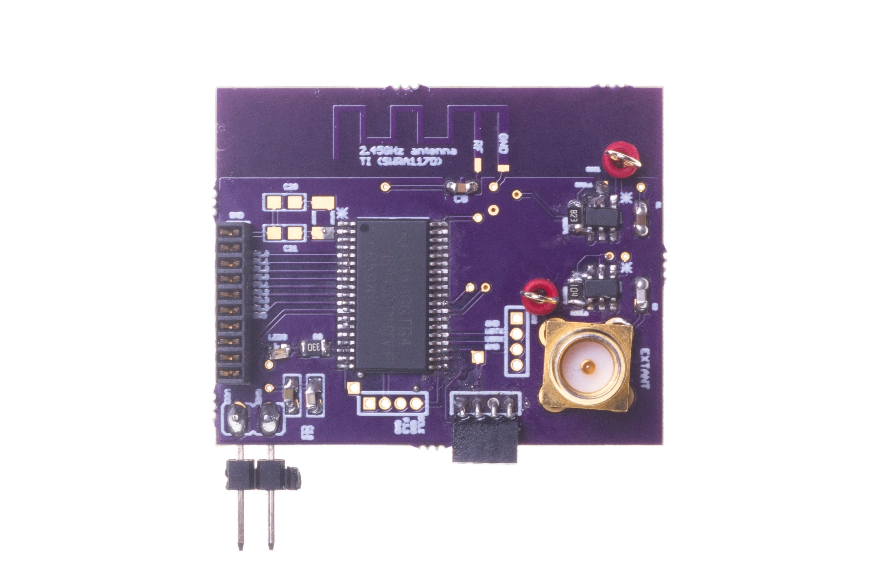
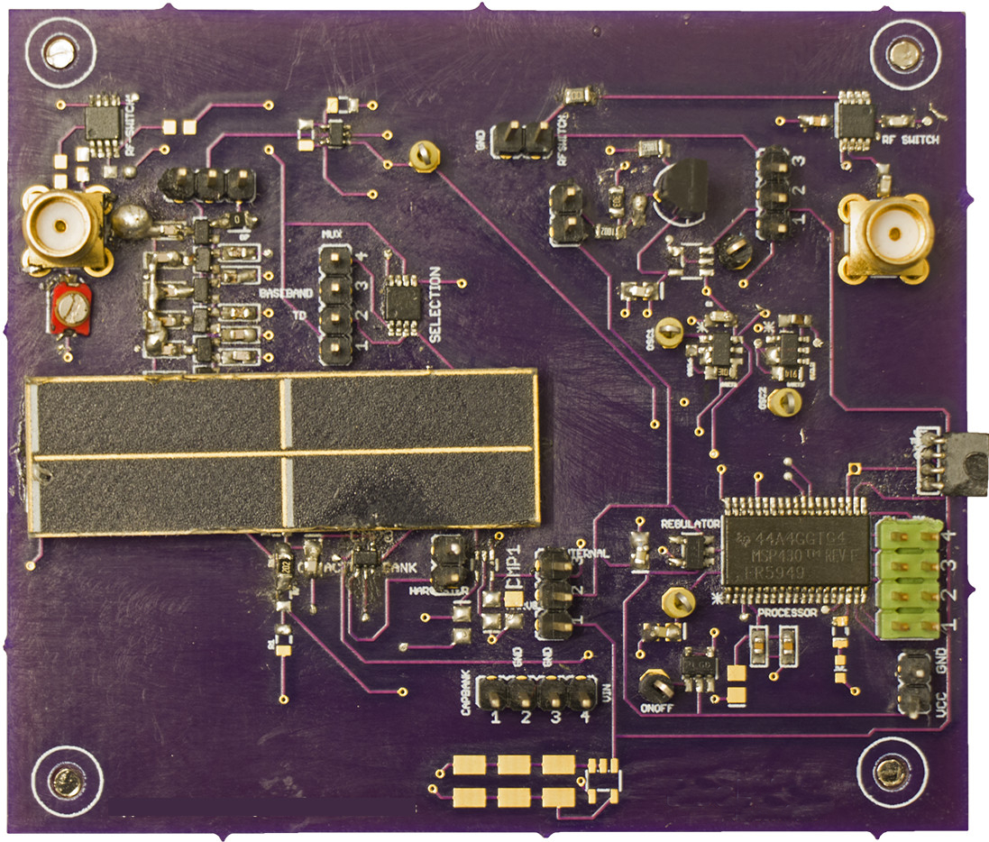
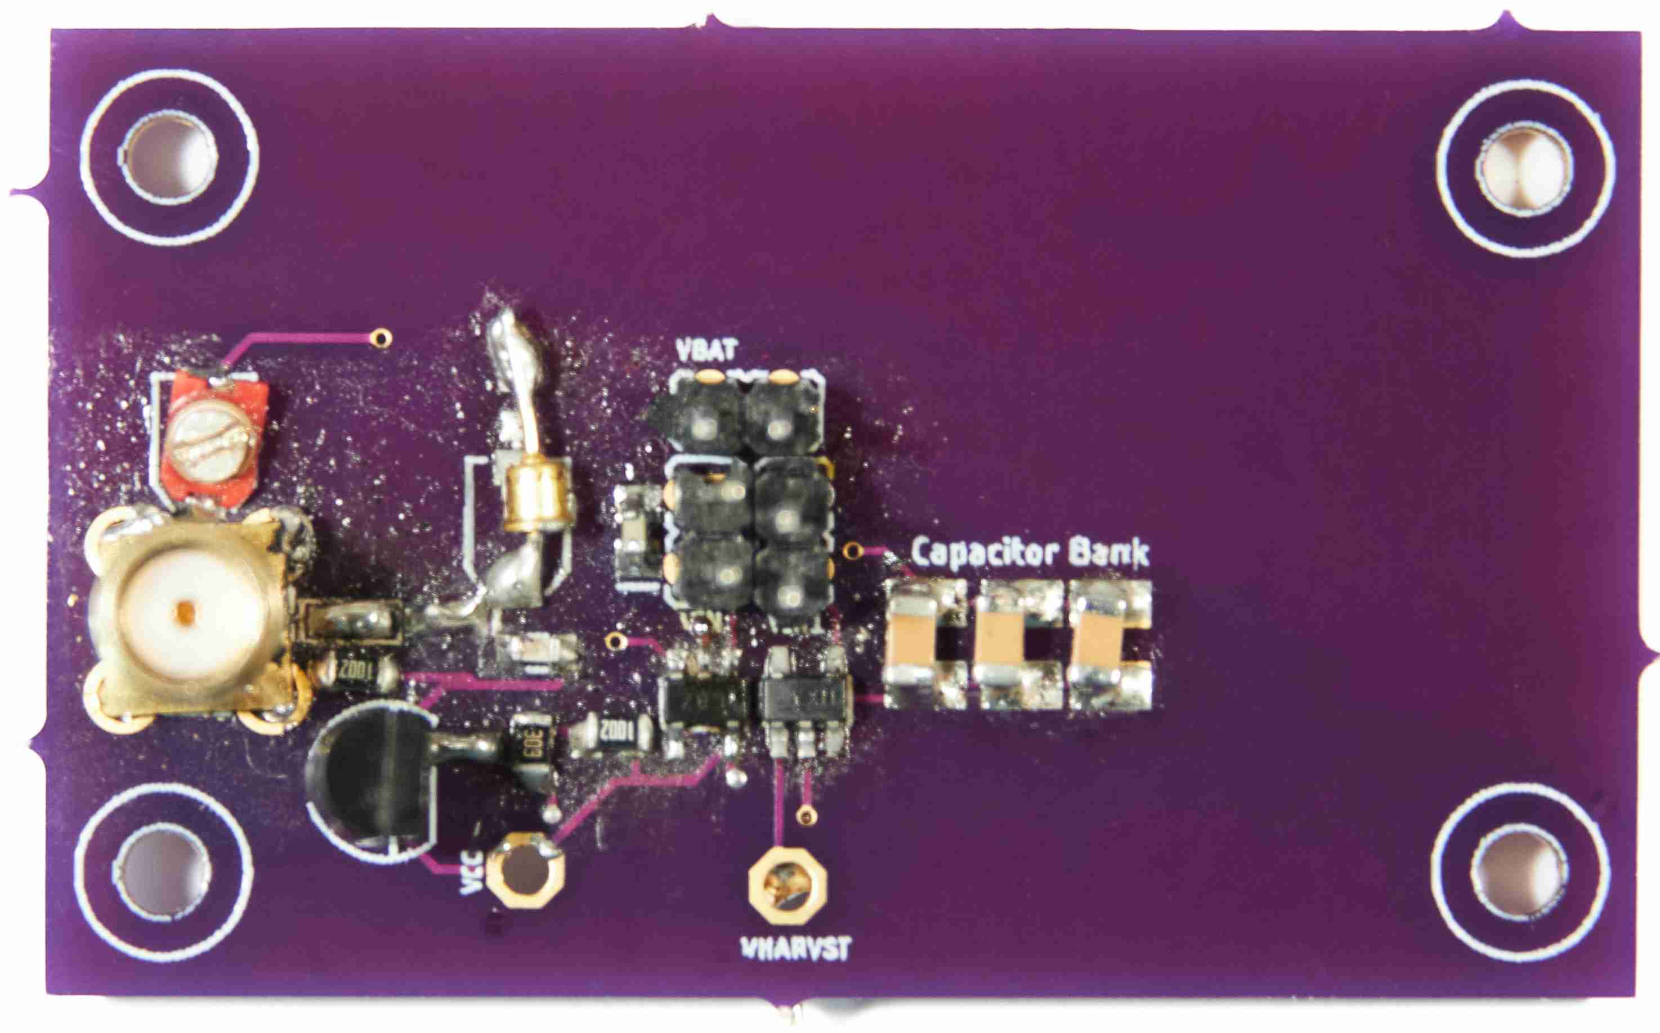
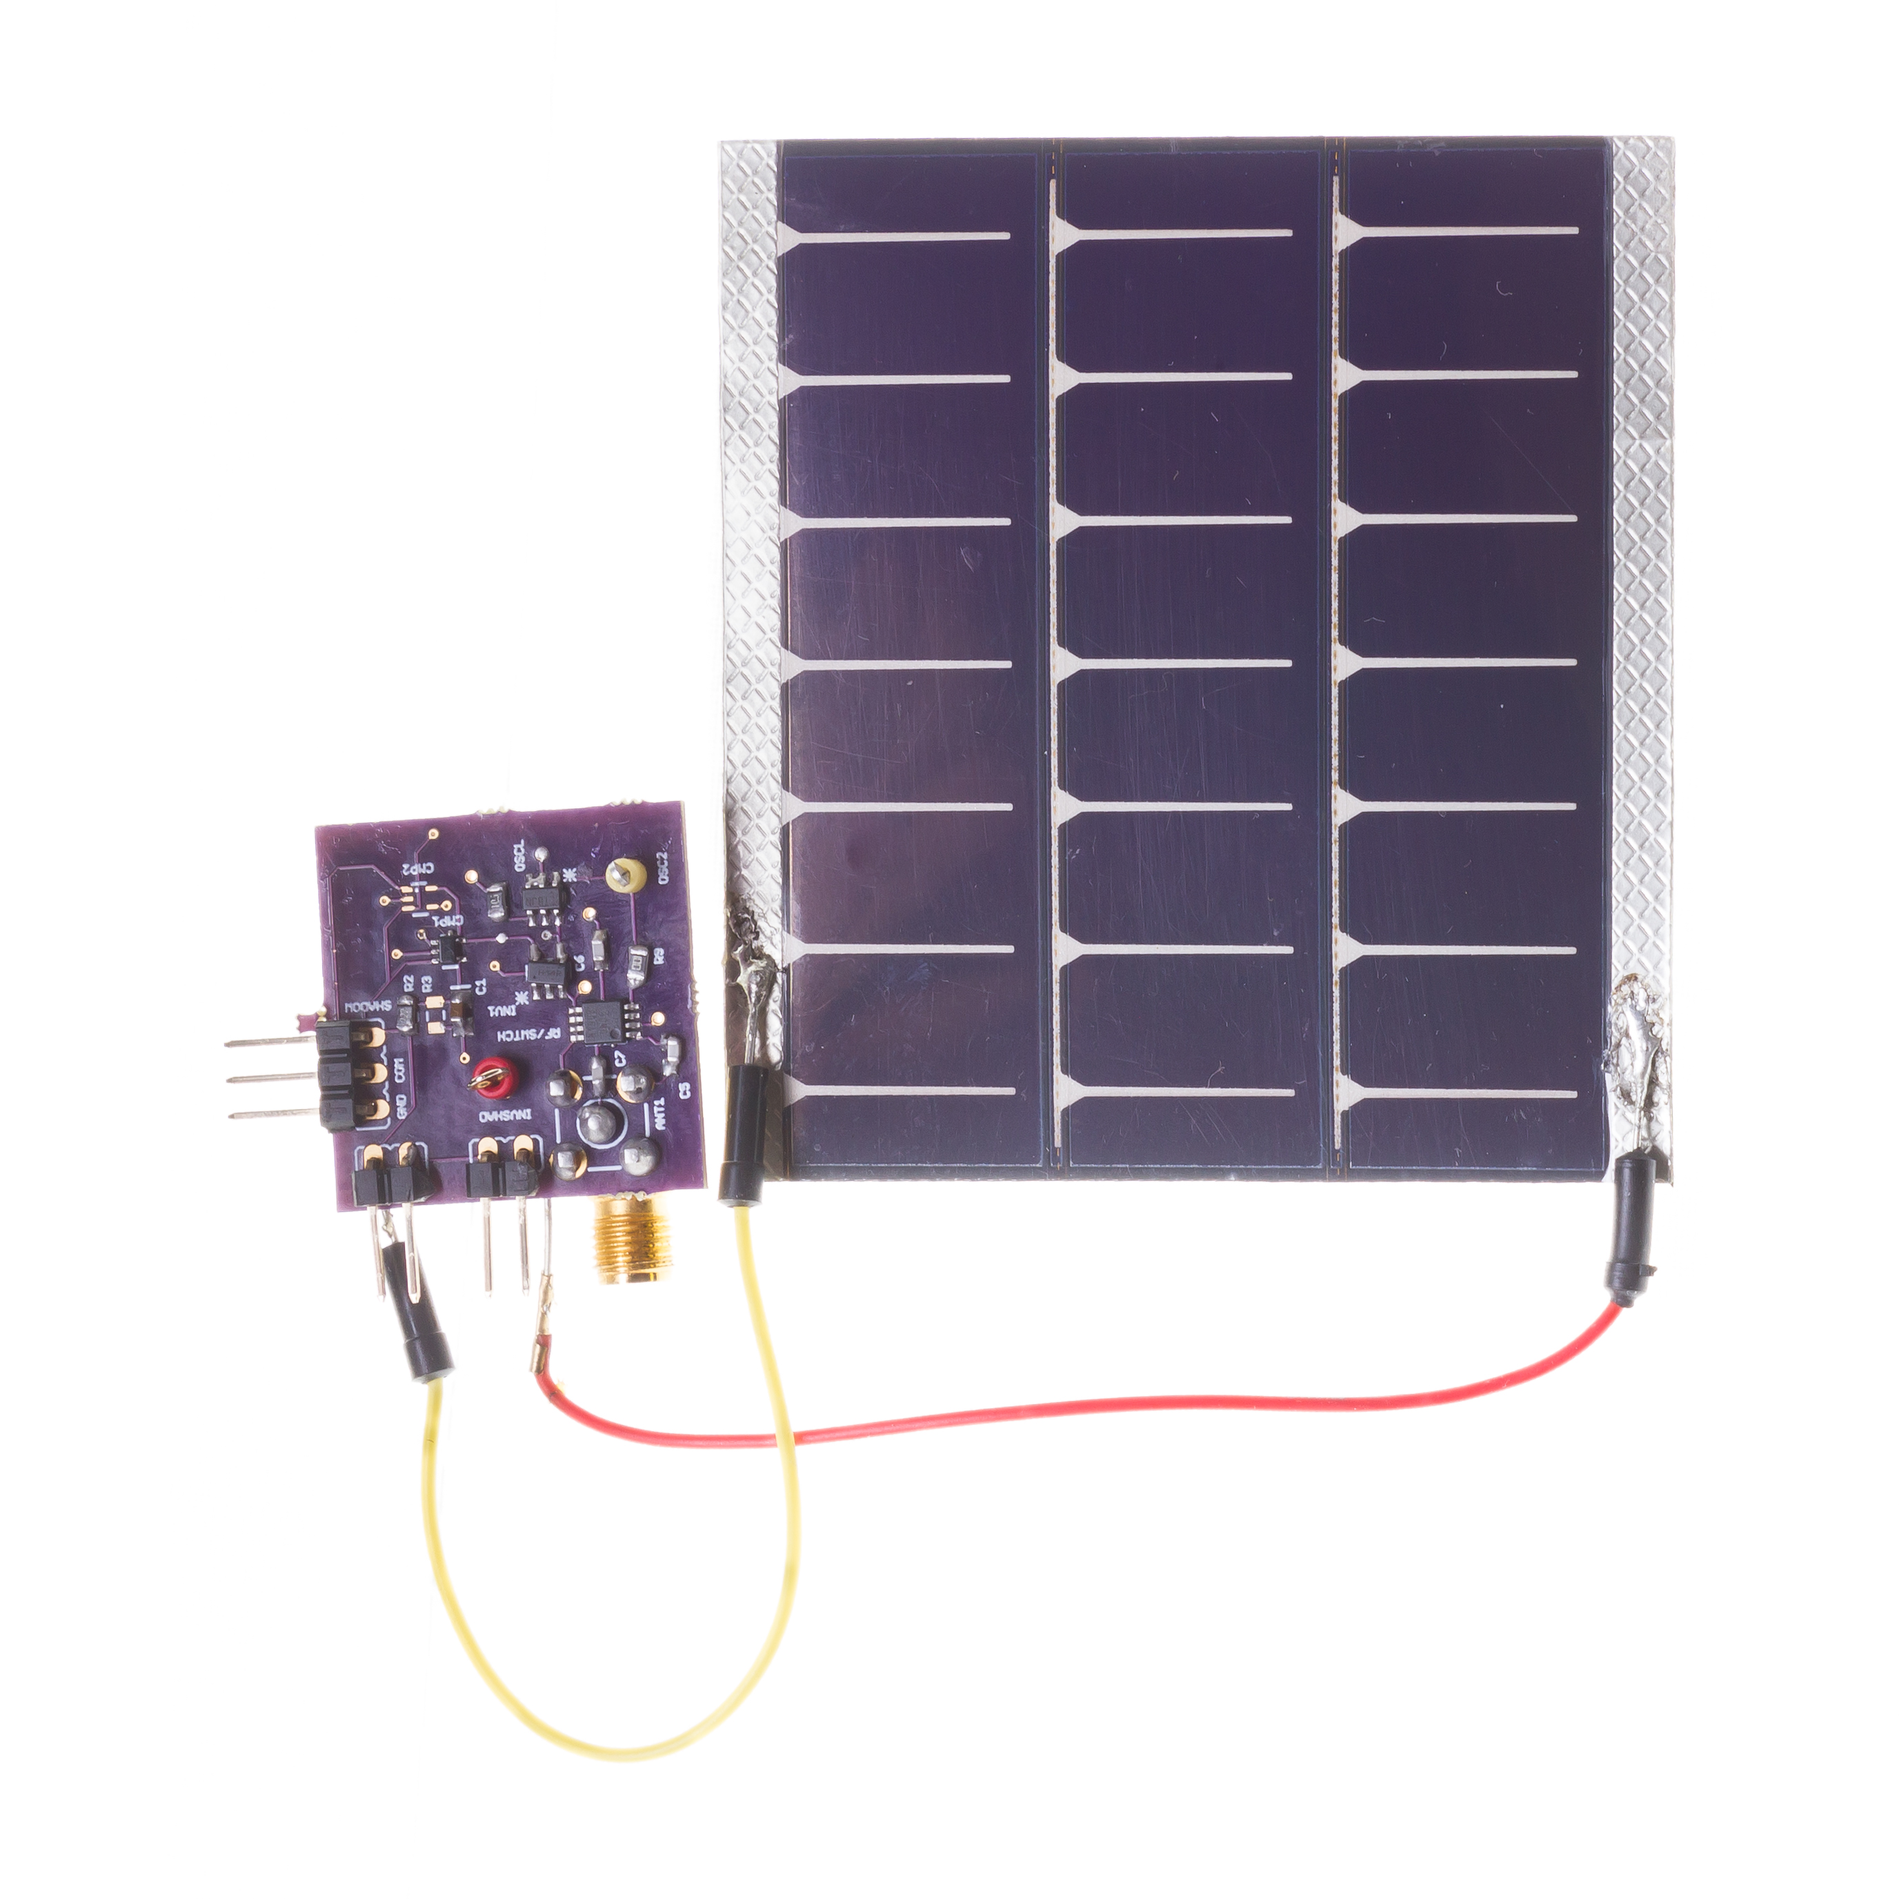
Let us get to know the instructor of the course
Build real embedded and wireless systems. Functional prototypes
Wireless embedded systems: Journey started over 14 years back!
Commonly, our work involves designing systems at the intersection of computer science, electrical engineering and computer communication
[ACM SENSYS 2017]
[ACM MOBISYS 2020]
[ACM MOBICOM 2020]
[ACM VLCS 2017]
Notes:
++ We may all have heard of the term Internet of Things. So how are these wireless embedded systems related to the Internet of Things: Today, IoT includes a broad class of devices, including powerful platforms such as smartphones. However, it also includes more resource-constrained devices and what we call Wireless Embedded Systems, and in fact, I consider it to be one of the essential parts of the IoT ecosystem.
++ These are platforms equipped with a radio transceiver, sensor, microcontroller, and some form of energy storage. These platforms also often form a network, and sensor network as it is called has been an active area of research for the past two decades.
++ The research community has also developed wireless embedded platforms which we may know about, and these include: CMUCAM, which is an image sensor platform developed at Carnegie Mellon University, or Permamote is long life sensor platform from the lab I am associated with at UC Berkeley or Lorea which is a long-range backscatter platform that I had developed as part of my doctoral dissertation at Uppsala University. All of these are an example of Wireless Embedded Systems.

Slide 5
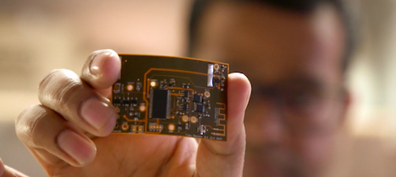


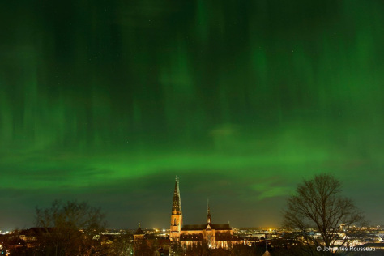

Let us get to know the instructor of the course
Doctoral studies conducted in Sweden. PhD from Uppsala University
Dissertation: Enabling sustainable networked embedded systems
Doctoral dissertation awarded 2019 ABB Research Award (Funded Postdoc)
Postdoctoral studies conducted at UC Berkeley
Make sticker computers! STICORS
Notes:
++ We may all have heard of the term Internet of Things. So how are these wireless embedded systems related to the Internet of Things: Today, IoT includes a broad class of devices, including powerful platforms such as smartphones. However, it also includes more resource-constrained devices and what we call Wireless Embedded Systems, and in fact, I consider it to be one of the essential parts of the IoT ecosystem.
++ These are platforms equipped with a radio transceiver, sensor, microcontroller, and some form of energy storage. These platforms also often form a network, and sensor network as it is called has been an active area of research for the past two decades.
++ The research community has also developed wireless embedded platforms which we may know about, and these include: CMUCAM, which is an image sensor platform developed at Carnegie Mellon University, or Permamote is long life sensor platform from the lab I am associated with at UC Berkeley or Lorea which is a long-range backscatter platform that I had developed as part of my doctoral dissertation at Uppsala University. All of these are an example of Wireless Embedded Systems.

Slide 6
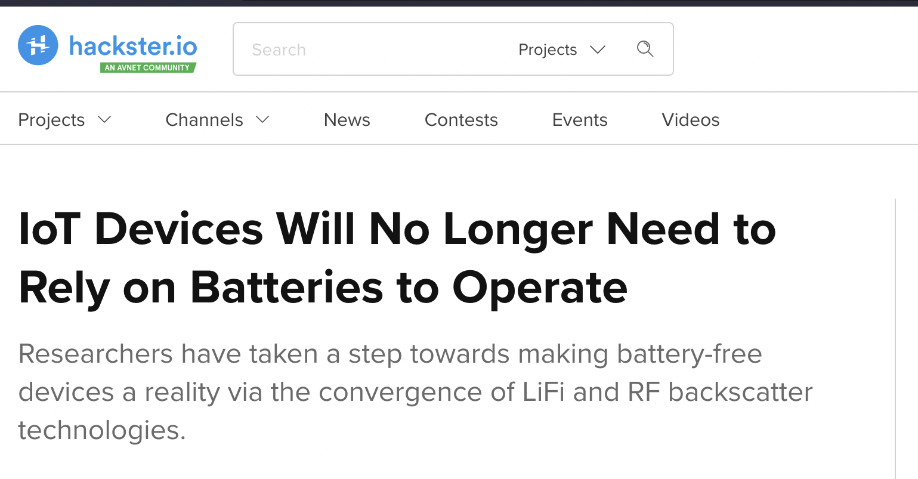

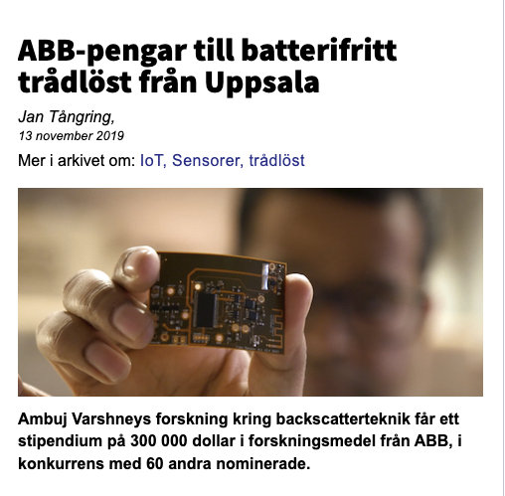
Wireless, Embedded Intelligence, Sensing and Emerging Technologies (WEISER) Group
World leading research in the area of wireless embedded systems
2 PhD students, 1 Postdoc, 1 RA, 3 NSWS (UG), 7 (UG, FYP), 3 (MCOMP)
Regularly publish research findings in flagship venues of the area;
ACM MobiCom, MobiSys, SenSys, Ipsn, HotNets, GetMobile and others
Research findings and awards are regularly covered by major media outlets
Notes:
++ We may all have heard of the term Internet of Things. So how are these wireless embedded systems related to the Internet of Things: Today, IoT includes a broad class of devices, including powerful platforms such as smartphones. However, it also includes more resource-constrained devices and what we call Wireless Embedded Systems, and in fact, I consider it to be one of the essential parts of the IoT ecosystem.
++ These are platforms equipped with a radio transceiver, sensor, microcontroller, and some form of energy storage. These platforms also often form a network, and sensor network as it is called has been an active area of research for the past two decades.
++ The research community has also developed wireless embedded platforms which we may know about, and these include: CMUCAM, which is an image sensor platform developed at Carnegie Mellon University, or Permamote is long life sensor platform from the lab I am associated with at UC Berkeley or Lorea which is a long-range backscatter platform that I had developed as part of my doctoral dissertation at Uppsala University. All of these are an example of Wireless Embedded Systems.

Slide 7

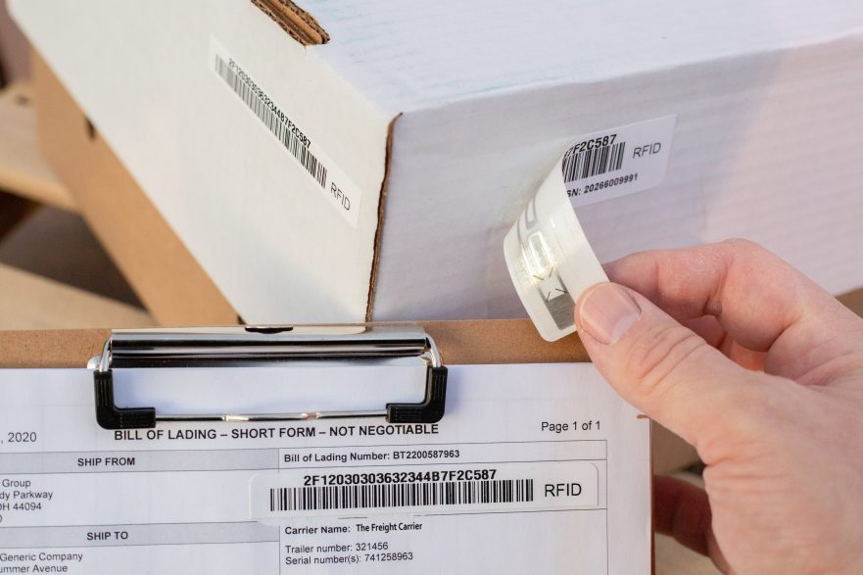
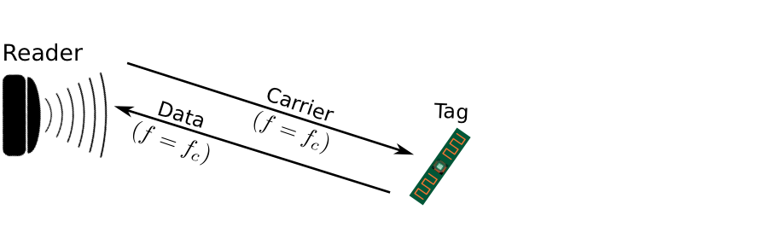
Enabling Sustainable, Large-scale Internet of Things
Internet of Things devices that can operate without batteries!
Breakthroughs to enable zero-power sensing and communication
Sensing and communication operations performed at microwatts of power
100-10,000X lower than state-of-the-art and commercial systems
RFID System
Notes:
++ We may all have heard of the term Internet of Things. So how are these wireless embedded systems related to the Internet of Things: Today, IoT includes a broad class of devices, including powerful platforms such as smartphones. However, it also includes more resource-constrained devices and what we call Wireless Embedded Systems, and in fact, I consider it to be one of the essential parts of the IoT ecosystem.
++ These are platforms equipped with a radio transceiver, sensor, microcontroller, and some form of energy storage. These platforms also often form a network, and sensor network as it is called has been an active area of research for the past two decades.
++ The research community has also developed wireless embedded platforms which we may know about, and these include: CMUCAM, which is an image sensor platform developed at Carnegie Mellon University, or Permamote is long life sensor platform from the lab I am associated with at UC Berkeley or Lorea which is a long-range backscatter platform that I had developed as part of my doctoral dissertation at Uppsala University. All of these are an example of Wireless Embedded Systems.

Slide 8
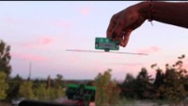
Reflecting Television Signals for Transmissions
Courtesy: University of Washington, Seattle
Ambient Backscatter: Wireless Communication Out of Thin Air, ACM SIGCOMM 2013

Slide 9
Long-range Backscatter Transmissions using LoRea
LoRea is a long range, low-power, and low-cost backscatter architecture
System Overview
Backscatter Tag Hardware Prototype
(Peak Power of 70 µW)
Varshney et al. ”LoRea: A Backscatter architecture that achieves a long communication range” ACM SENSYS 2017
Notes:
+ Over the past several years, I have designed systems that overcome these critical limitations that have hindered the backscatter systems and have the prevented widespread adoption of the backscatter mechanisms on the Internet of Things devices. One of these systems is LoRea.
+ LoRea was presented at ACM SENSYS, which is a flagship conference in the area of embedded sensor systems. I show the architecture of LoRea on the left-hand figure on the slide. It consists of one or more commodity devices such as a smartphone or Wi-Fi router that provides the necessary carrier signal to support backscatter transmissions, a low-power backscatter tag that I had designed and transmit at a peak power of 70uw, and one or more receiver of backscatter transmissions.
+ The key highlight of LoRea was that it could achieve a significantly larger communication range than existing systems, was designed using off the shelf components and cost (few tens of USDs). Further, the backscatter tag could achieve this capability at orders of magnitude lower energy than commercially available radio transceivers.
+ How did LoRea achieve this capability? We would describe next.

Slide 10
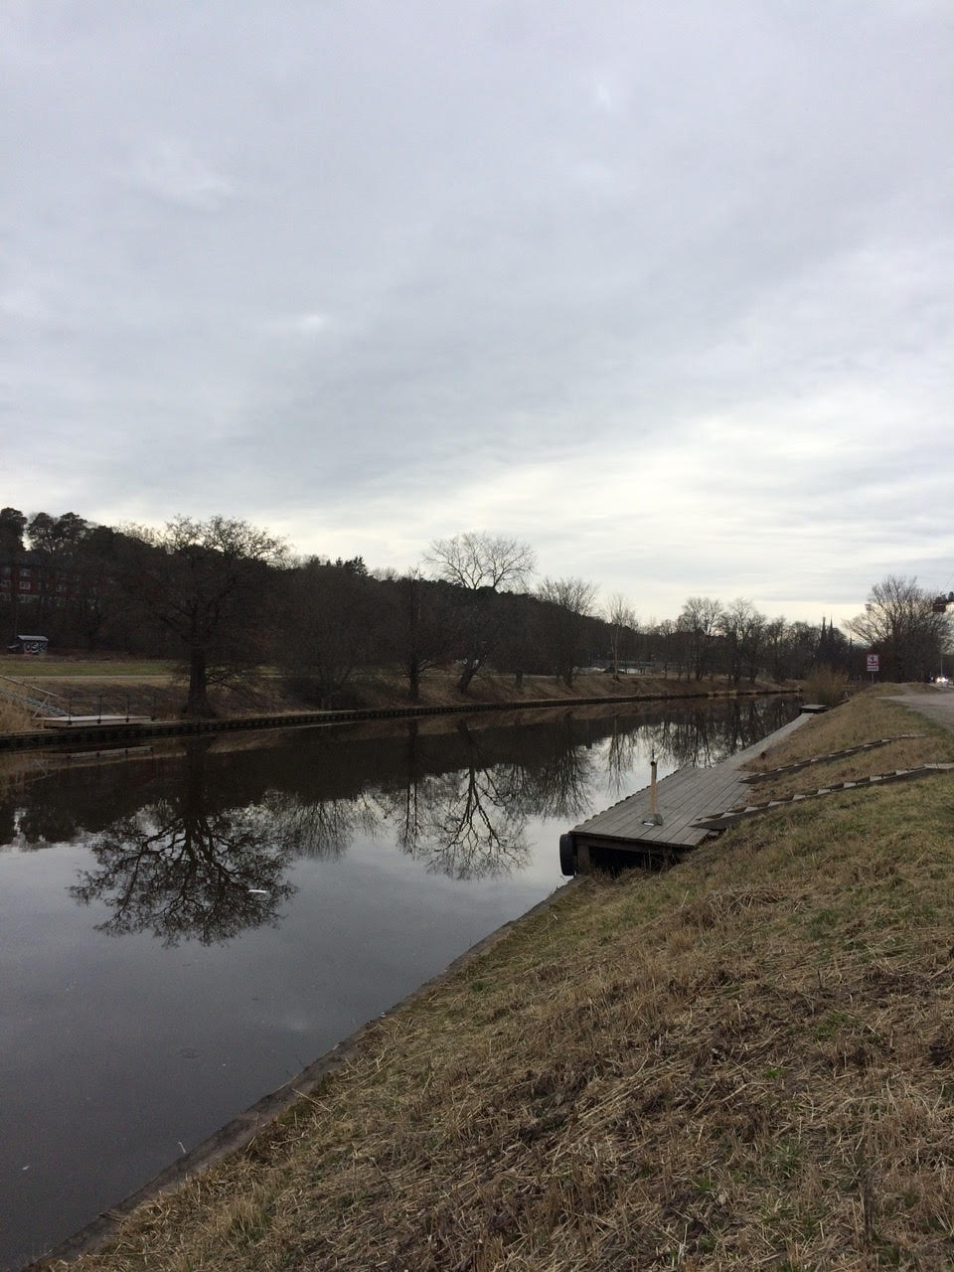
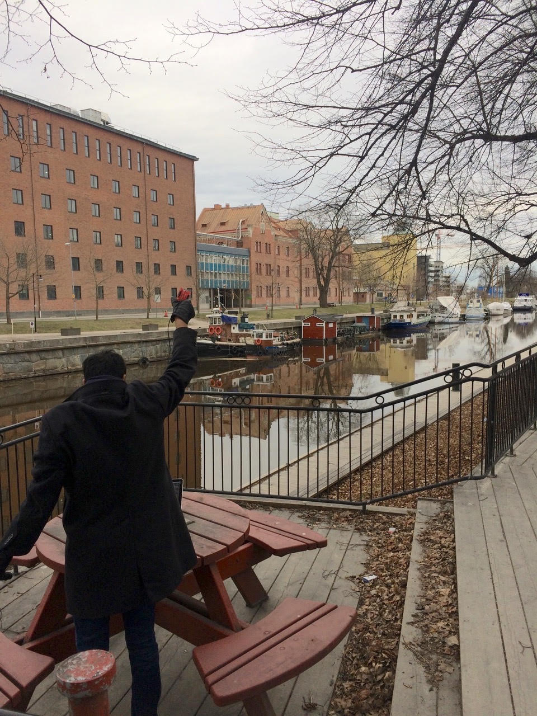
We ran out of space while performing experiments
State-of-art few meters. We achieved kilometers, was difficult to anticipate
Initial experiments conducted near the university and a river in Uppsala
Experiment Setup
Receiving transmissions 1km away from the setup
Notes:
Incorporating these three design elements, allows us to significantly push the communication range of the system. Next, we did experiments to investigate the transmission range that we can support with our system.
Performing these experiments was challenging as when we were designing LoRea the state of the art backscatter systems achieved a communication range of tens of meters. Hence, it was difficult to anticipate space required to perform these experiments.
We conducted the first experiment in the university, and we ran out the space, next we took the experiment setup next to a river in Uppsala. I show the setup on left hand side image, and on the right is picture of me capturing transmissions one kilometer away. However, while we were able to receive transmissions at fairly high SNR, we again ran out of space due to large range that we could achieve.

Slide 11
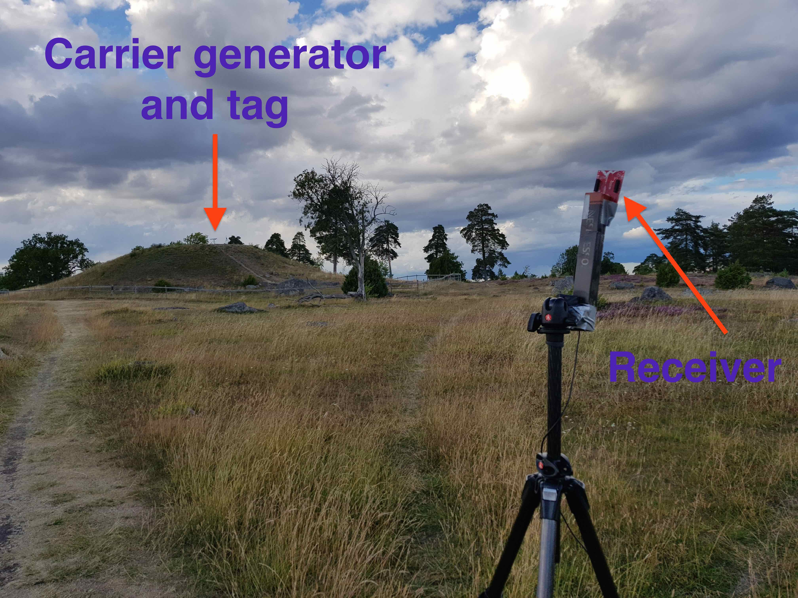
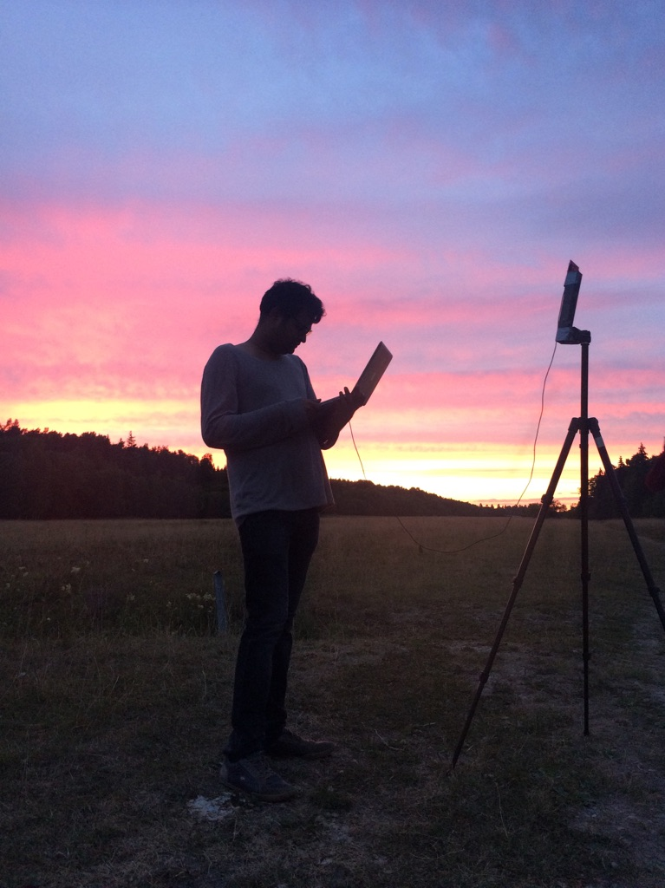
LoRea achieved the highest demonstrated range
Receive up to a distance of 3.4 kilometers from tag
Highest demonstrated range. Outperforms leading labs/universities
Experiment Setup
(On a small hill)
Receiving backscatter transmissions kilometers away from setup
Notes:
Hence, to find the maximum range we could achieve with our system, we took the entire setup outside Uppsala to an open space. We kept the backscatter setup on top of a small hill, and investigated the maximum communication range that we could support.
Performing these experiments was significantly challenging, as we would setup experiment in the daytime, and by the time we would finish collecting the link metrics, it would be dawn. We also had to walk significant distances with equipment.
We found that we could communicate up to a distance of 3.4 km while consuming tens of microwatts of power for wireless transmissions at the backscatter tag. Achieving such high communication range was considered challenging or even infeasible with backscatter mechanism, and LoRea helped overturn notion that backscatter is a low range transmission mechanism.

Slide 12
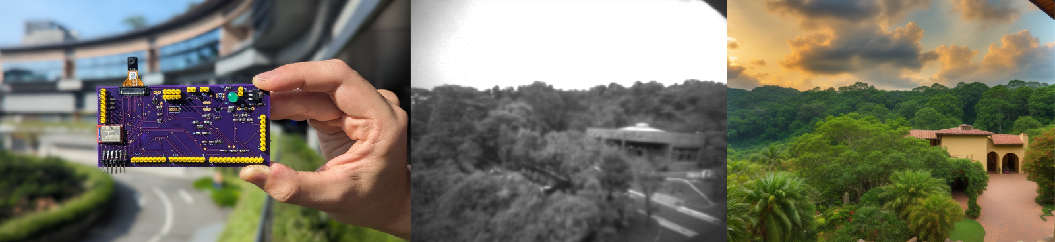
Rethinking Embedded Camera Systems
Intersection of Image/Language models with embedded systems
Low-power hardware, generate a rich representations of the world
Applications: Extended Reality! And many more!
Notes:
++ We may all have heard of the term Internet of Things. So how are these wireless embedded systems related to the Internet of Things: Today, IoT includes a broad class of devices, including powerful platforms such as smartphones. However, it also includes more resource-constrained devices and what we call Wireless Embedded Systems, and in fact, I consider it to be one of the essential parts of the IoT ecosystem.
++ These are platforms equipped with a radio transceiver, sensor, microcontroller, and some form of energy storage. These platforms also often form a network, and sensor network as it is called has been an active area of research for the past two decades.
++ The research community has also developed wireless embedded platforms which we may know about, and these include: CMUCAM, which is an image sensor platform developed at Carnegie Mellon University, or Permamote is long life sensor platform from the lab I am associated with at UC Berkeley or Lorea which is a long-range backscatter platform that I had developed as part of my doctoral dissertation at Uppsala University. All of these are an example of Wireless Embedded Systems.

Slide 13
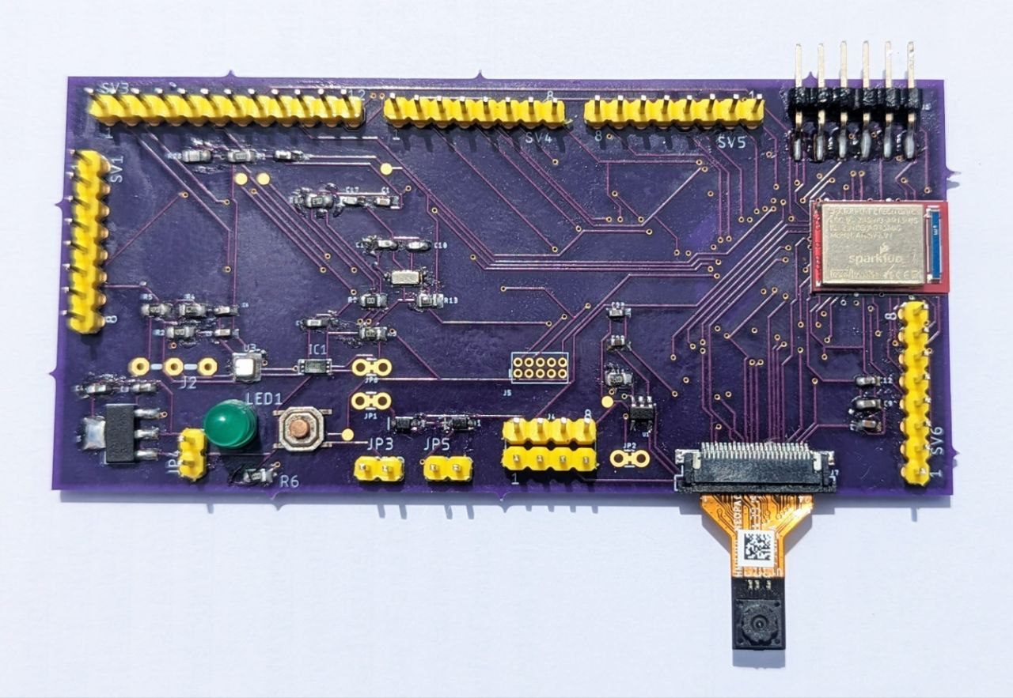
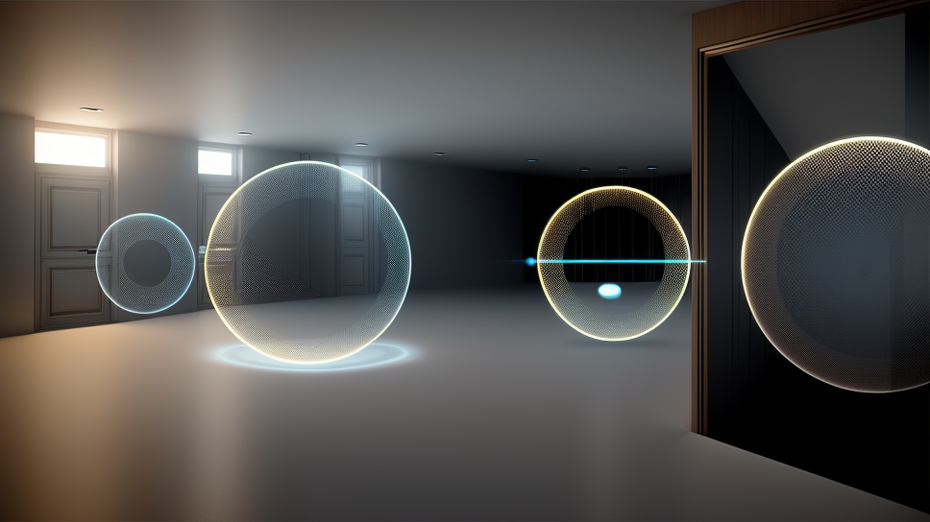
Rethinking Embedded Camera Systems
Intersection of Image/Language models with embedded systems
Low-power hardware, generate a rich representations of the world
Applications: Extended Reality! And many more!
Notes:
++ We may all have heard of the term Internet of Things. So how are these wireless embedded systems related to the Internet of Things: Today, IoT includes a broad class of devices, including powerful platforms such as smartphones. However, it also includes more resource-constrained devices and what we call Wireless Embedded Systems, and in fact, I consider it to be one of the essential parts of the IoT ecosystem.
++ These are platforms equipped with a radio transceiver, sensor, microcontroller, and some form of energy storage. These platforms also often form a network, and sensor network as it is called has been an active area of research for the past two decades.
++ The research community has also developed wireless embedded platforms which we may know about, and these include: CMUCAM, which is an image sensor platform developed at Carnegie Mellon University, or Permamote is long life sensor platform from the lab I am associated with at UC Berkeley or Lorea which is a long-range backscatter platform that I had developed as part of my doctoral dissertation at Uppsala University. All of these are an example of Wireless Embedded Systems.

Slide 14
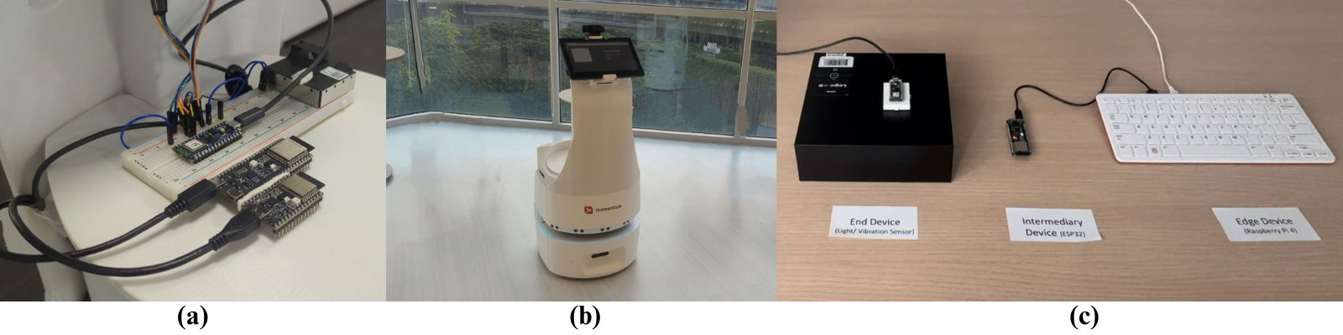
Controlling robots through voice and language models
Notes:
++ We may all have heard of the term Internet of Things. So how are these wireless embedded systems related to the Internet of Things: Today, IoT includes a broad class of devices, including powerful platforms such as smartphones. However, it also includes more resource-constrained devices and what we call Wireless Embedded Systems, and in fact, I consider it to be one of the essential parts of the IoT ecosystem.
++ These are platforms equipped with a radio transceiver, sensor, microcontroller, and some form of energy storage. These platforms also often form a network, and sensor network as it is called has been an active area of research for the past two decades.
++ The research community has also developed wireless embedded platforms which we may know about, and these include: CMUCAM, which is an image sensor platform developed at Carnegie Mellon University, or Permamote is long life sensor platform from the lab I am associated with at UC Berkeley or Lorea which is a long-range backscatter platform that I had developed as part of my doctoral dissertation at Uppsala University. All of these are an example of Wireless Embedded Systems.

Slide 15
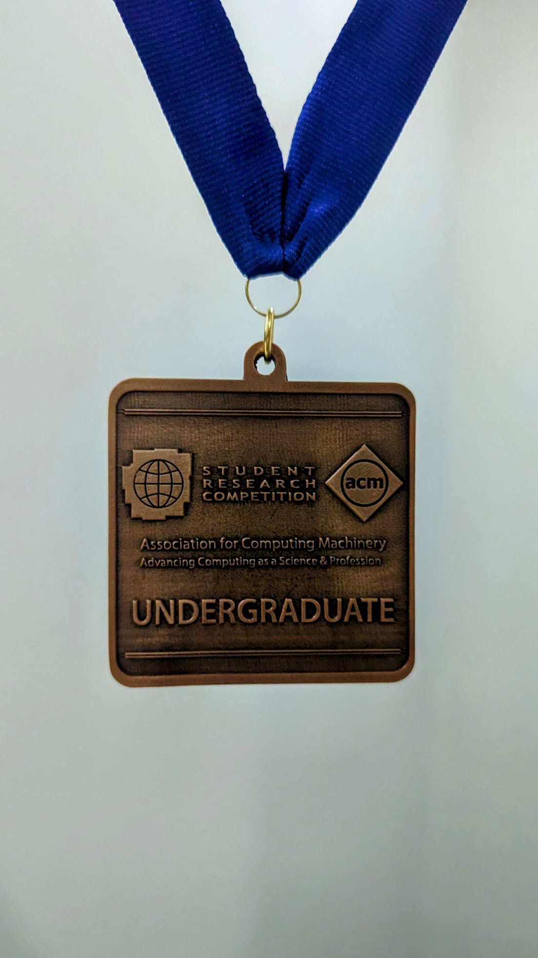
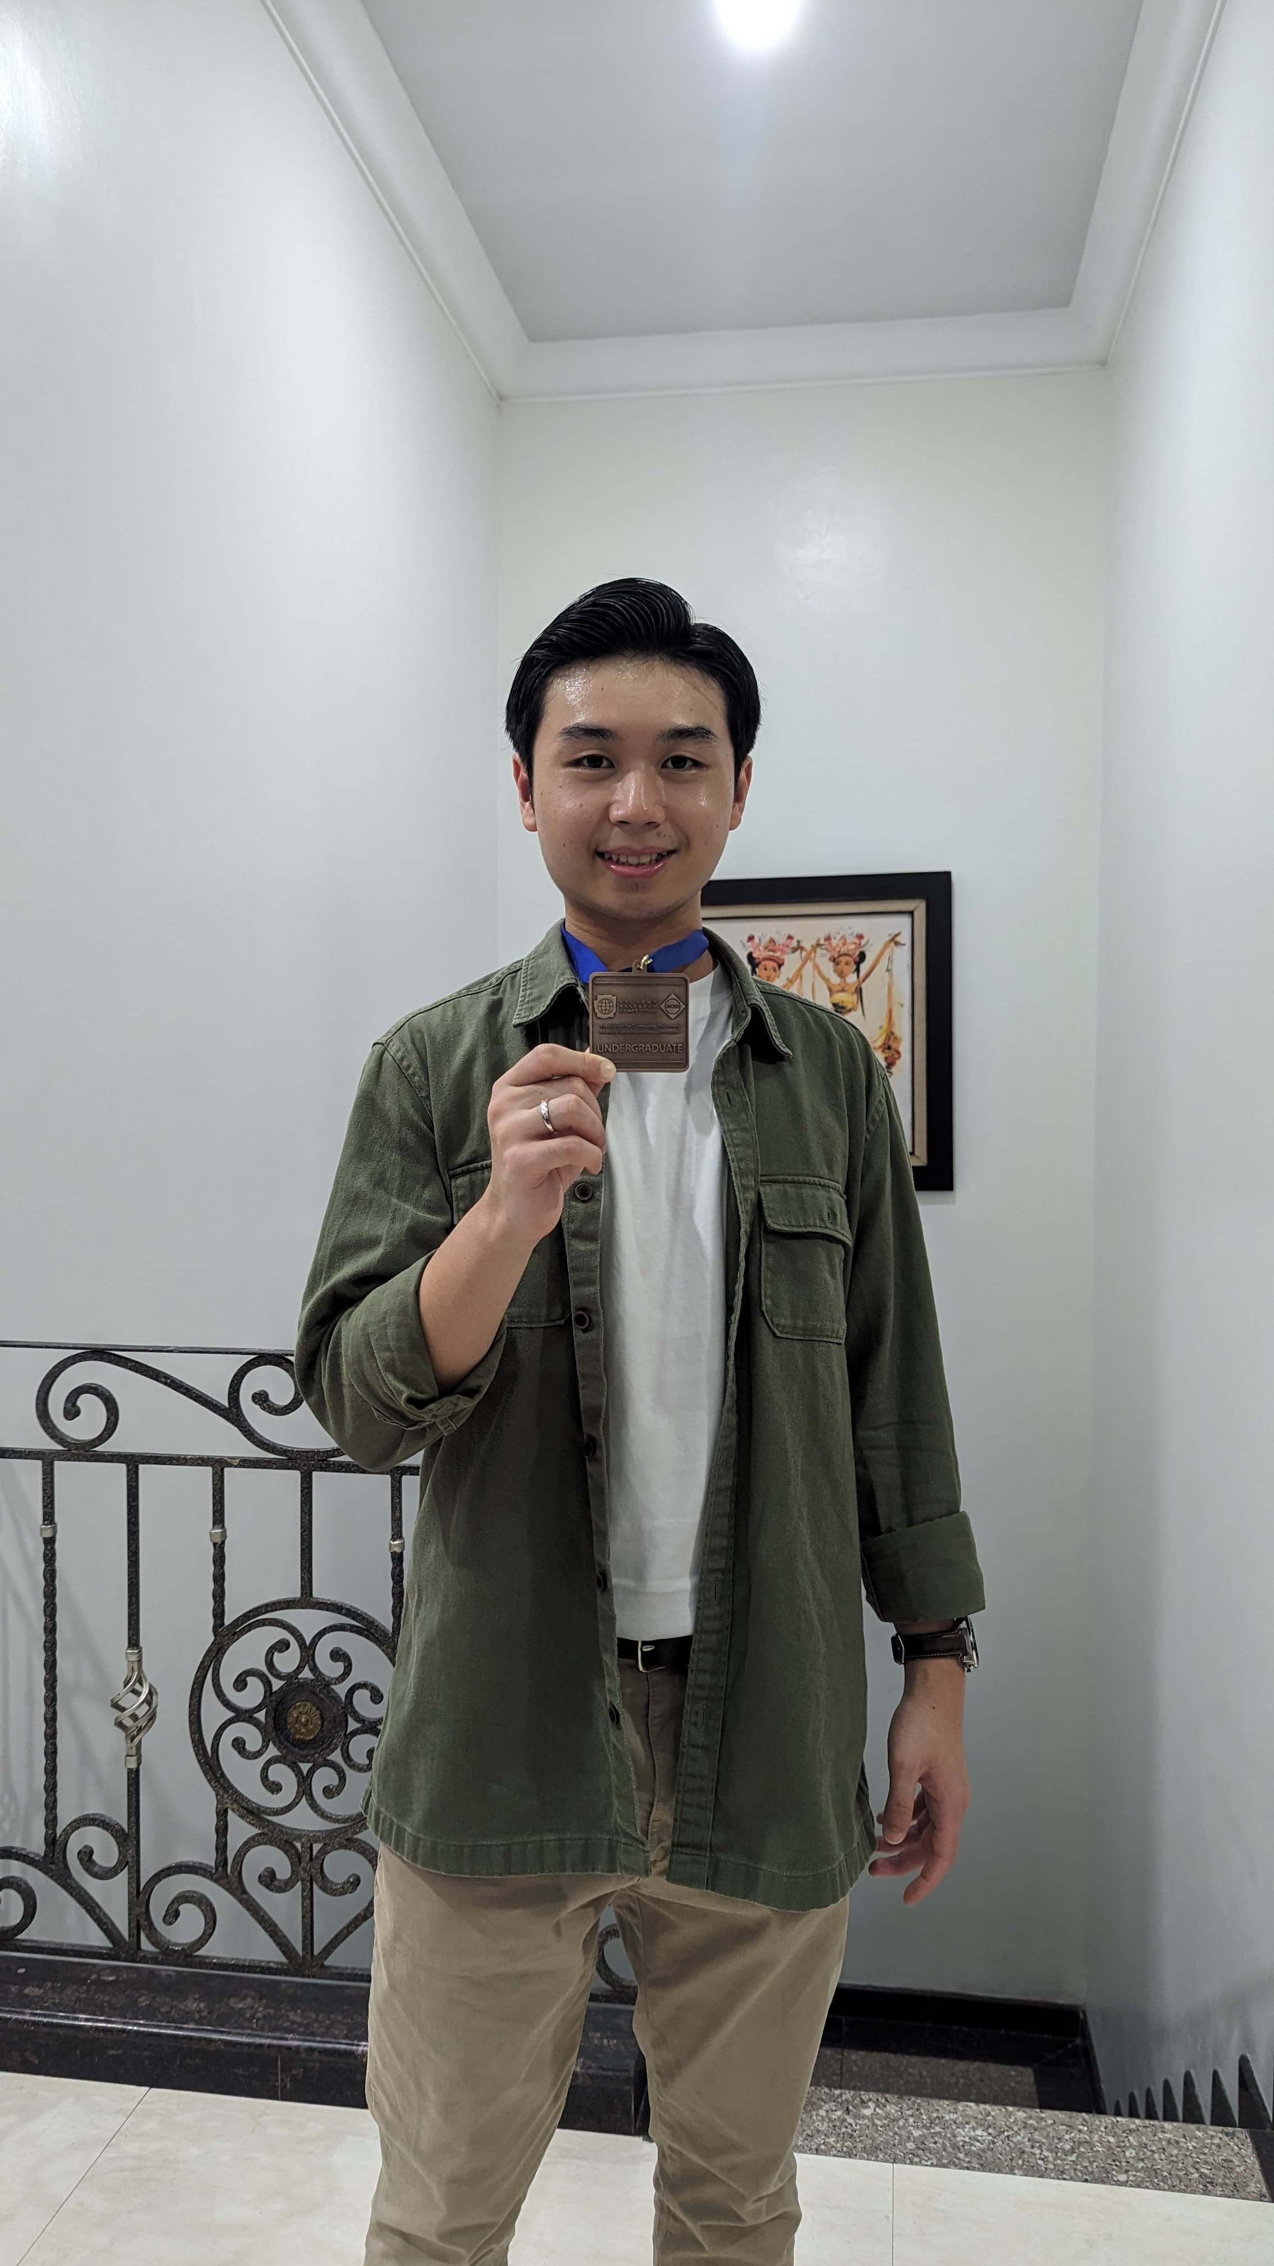
We really like to work with undergraduate students
We enjoy working with undergraduate students!
Diverse environment
Students visiting our group from the best universities in the world
Awards for mentored students
High-quality research, have fun, and stipend!
Higher studies
Entrepreneurship
Job opportunities
Notes:
++ We may all have heard of the term Internet of Things. So how are these wireless embedded systems related to the Internet of Things: Today, IoT includes a broad class of devices, including powerful platforms such as smartphones. However, it also includes more resource-constrained devices and what we call Wireless Embedded Systems, and in fact, I consider it to be one of the essential parts of the IoT ecosystem.
++ These are platforms equipped with a radio transceiver, sensor, microcontroller, and some form of energy storage. These platforms also often form a network, and sensor network as it is called has been an active area of research for the past two decades.
++ The research community has also developed wireless embedded platforms which we may know about, and these include: CMUCAM, which is an image sensor platform developed at Carnegie Mellon University, or Permamote is long life sensor platform from the lab I am associated with at UC Berkeley or Lorea which is a long-range backscatter platform that I had developed as part of my doctoral dissertation at Uppsala University. All of these are an example of Wireless Embedded Systems.

Slide 16
Roadmap of the lecture today
Let us get to know the instructor ☺
What is this course about? Logistics? Grading Criteria?
Introduction to Embedded Systems (aka IoT)
Mark Weiser Vision for Ubiquitous Computing
Basics of Wireless Communication and Signal Propagation
Notes:
Here is the roadmap of the major topics that I am going to cover during the presentation. We have already covered the exponential growth of the internet of things; next, I will talk about the critical energy challenge that can severely hinder this massive growth and preventing us from realising this immense economic value enabled by the IoT.

Slide 17
Course Information
Notes:
++ Over the past few years, I have designed several backscatter and beyond backscatter systems that precisely overcome these critical challenges that have limited the widespread deployment of backscatter on IoT devices.
++ The research vision that I have pursued and would like to pursue as a faculty member is to enable a massive deployment of IoT devices by bridging the energy asymmetry between sensing, computation and communication blocks by designing novel platforms and communication mechanisms. I am going to describe some of my research contributions next.

Slide 18
General information regarding the course
Course code: 4222/5422, Day of week: Friday, 6:30 to 8:30 pm (Lectures)
Tutorials: Starting 29th January! Seven slots. You should have selected.
Problems: Please email me!
Office hours: COM3 - #2 – 25, Friday : 4 – 6 pm (by appointment)
Please send me an email to reserve slot
What can you discuss? Anything related to course or wireless networking
Notes:
++ We may all have heard of the term Internet of Things. So how are these wireless embedded systems related to the Internet of Things: Today, IoT includes a broad class of devices, including powerful platforms such as smartphones. However, it also includes more resource-constrained devices and what we call Wireless Embedded Systems, and in fact, I consider it to be one of the essential parts of the IoT ecosystem.
++ These are platforms equipped with a radio transceiver, sensor, microcontroller, and some form of energy storage. These platforms also often form a network, and sensor network as it is called has been an active area of research for the past two decades.
++ The research community has also developed wireless embedded platforms which we may know about, and these include: CMUCAM, which is an image sensor platform developed at Carnegie Mellon University, or Permamote is long life sensor platform from the lab I am associated with at UC Berkeley or Lorea which is a long-range backscatter platform that I had developed as part of my doctoral dissertation at Uppsala University. All of these are an example of Wireless Embedded Systems.

Slide 19

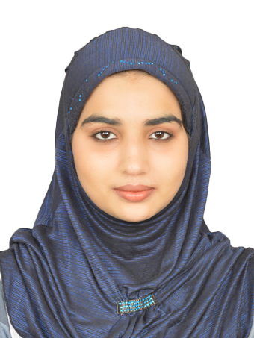

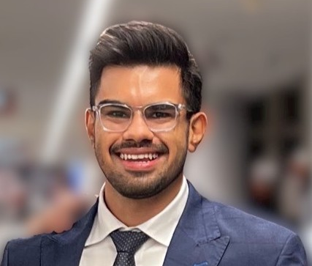

Brilliant teaching assistants of the course
Tutorials: They are starting beginning of Week 3
Malaika Afra Taj (PhD Student, SoC)
Kanav Sabharwal (PhD Student, SoC)
Ayanga Kalupahana (PhD Student SoC)
Rajashekar Chinthalapani (PhD Student SoC)
Pramuka Medaranga (PhD Student SoC)
Notes:
++ We may all have heard of the term Internet of Things. So how are these wireless embedded systems related to the Internet of Things: Today, IoT includes a broad class of devices, including powerful platforms such as smartphones. However, it also includes more resource-constrained devices and what we call Wireless Embedded Systems, and in fact, I consider it to be one of the essential parts of the IoT ecosystem.
++ These are platforms equipped with a radio transceiver, sensor, microcontroller, and some form of energy storage. These platforms also often form a network, and sensor network as it is called has been an active area of research for the past two decades.
++ The research community has also developed wireless embedded platforms which we may know about, and these include: CMUCAM, which is an image sensor platform developed at Carnegie Mellon University, or Permamote is long life sensor platform from the lab I am associated with at UC Berkeley or Lorea which is a long-range backscatter platform that I had developed as part of my doctoral dissertation at Uppsala University. All of these are an example of Wireless Embedded Systems.

Slide 20
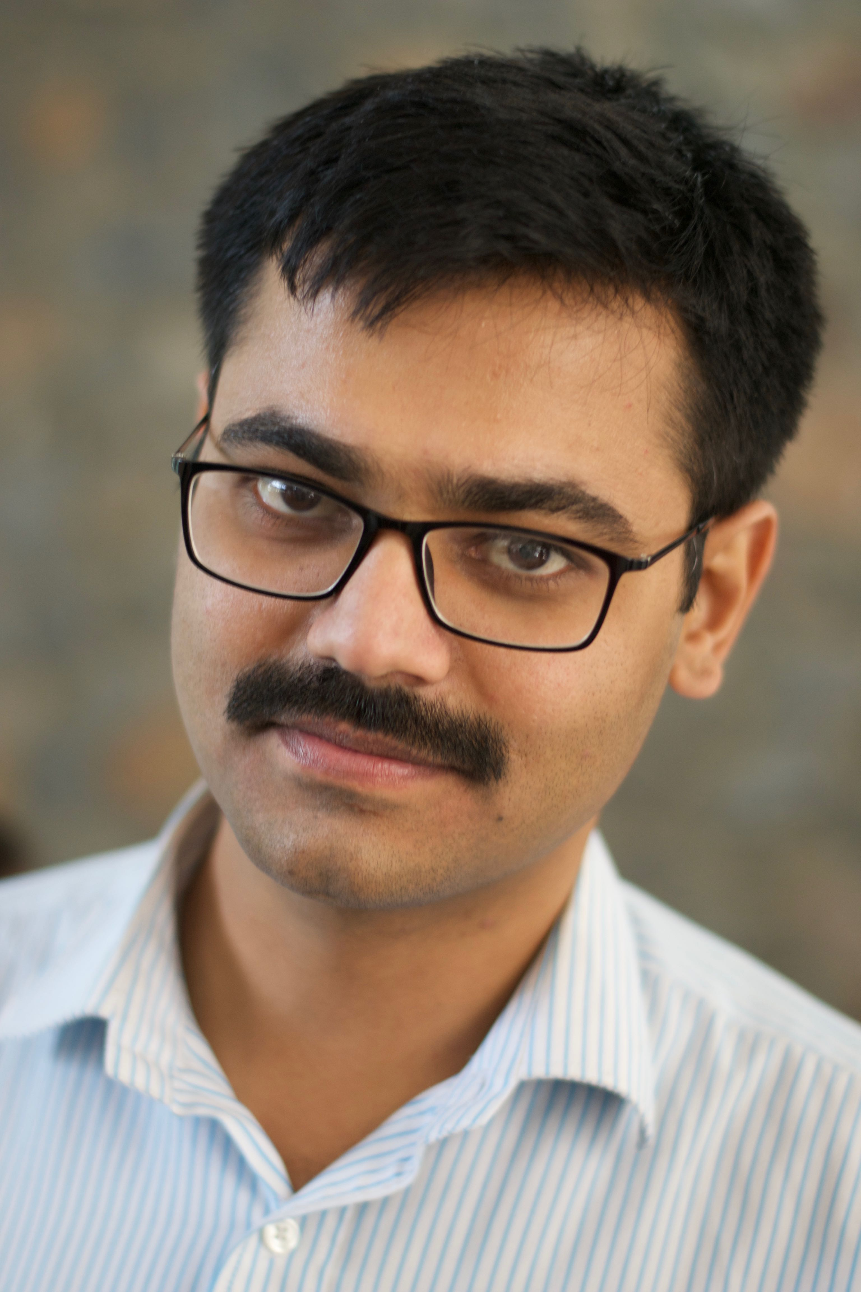
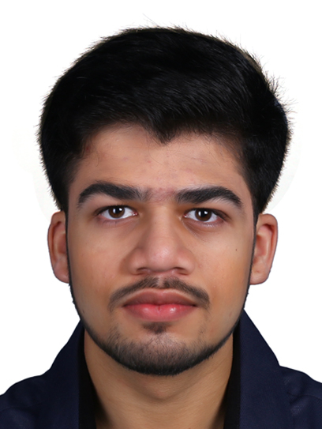
Support staff to help with the course
Dr. Manoj Gulati (Research Fellow)
Dhairya Jigar Shah (Research Assistant)
Notes:
++ We may all have heard of the term Internet of Things. So how are these wireless embedded systems related to the Internet of Things: Today, IoT includes a broad class of devices, including powerful platforms such as smartphones. However, it also includes more resource-constrained devices and what we call Wireless Embedded Systems, and in fact, I consider it to be one of the essential parts of the IoT ecosystem.
++ These are platforms equipped with a radio transceiver, sensor, microcontroller, and some form of energy storage. These platforms also often form a network, and sensor network as it is called has been an active area of research for the past two decades.
++ The research community has also developed wireless embedded platforms which we may know about, and these include: CMUCAM, which is an image sensor platform developed at Carnegie Mellon University, or Permamote is long life sensor platform from the lab I am associated with at UC Berkeley or Lorea which is a long-range backscatter platform that I had developed as part of my doctoral dissertation at Uppsala University. All of these are an example of Wireless Embedded Systems.

Slide 21
Course webpage and lecture recordings
Course webpage: https://weiserlab.github.io/wirelessnetworking/
Canvas: It will be used for submission of project/assignment
Piazza: A forum for discussions. Will be enabled soon
Look out for emails with subject (CS4222) for the announcements
How about lecture videos?
Registered to record class lecture videos. There maybe hiccups for first few
The recorded videos will be made available on the canvas
Last years lecture video are already linked to the course page
Caution: Some parts of the course have undergone change. Prior years lecture may cover additional material or material not planned this year
Notes:
++ We may all have heard of the term Internet of Things. So how are these wireless embedded systems related to the Internet of Things: Today, IoT includes a broad class of devices, including powerful platforms such as smartphones. However, it also includes more resource-constrained devices and what we call Wireless Embedded Systems, and in fact, I consider it to be one of the essential parts of the IoT ecosystem.
++ These are platforms equipped with a radio transceiver, sensor, microcontroller, and some form of energy storage. These platforms also often form a network, and sensor network as it is called has been an active area of research for the past two decades.
++ The research community has also developed wireless embedded platforms which we may know about, and these include: CMUCAM, which is an image sensor platform developed at Carnegie Mellon University, or Permamote is long life sensor platform from the lab I am associated with at UC Berkeley or Lorea which is a long-range backscatter platform that I had developed as part of my doctoral dissertation at Uppsala University. All of these are an example of Wireless Embedded Systems.

Slide 22
What is this course all about?
Notes:
++ Over the past few years, I have designed several backscatter and beyond backscatter systems that precisely overcome these critical challenges that have limited the widespread deployment of backscatter on IoT devices.
++ The research vision that I have pursued and would like to pursue as a faculty member is to enable a massive deployment of IoT devices by bridging the energy asymmetry between sensing, computation and communication blocks by designing novel platforms and communication mechanisms. I am going to describe some of my research contributions next.

Slide 23
CS4222: What is this course about?
This course provides an introduction to wireless networking. It covers the fundamental concepts, including signal propagation, modulation, and energy consumption estimation. Building upon these foundational topics, the course explores various layers of the wireless networking stack, including physical, MAC, networking and application layers. These lead to case studies covering commodity wireless standards (like WiFi, Bluetooth), Cellular networks, and the Internet of Things (IoT). Throughout the course, students will participate in tutorials, assignments and hands-on projects, enabling them to apply concepts and develop software prototypes for real IoT devices, thus translating the knowledge acquired into practical scenarios.
Notes:
Why do the IoT platforms suffer from this energy challenge? To understand this, we investigate the architecture of the IoT device. We show this architecture in the figure on the slide. It consists of a series of stages that enable us to sense physical phenomena, process and transmit the sensor information through a transceiver such as ZigBee/BLE/LoRa.
This architecture has remained unchanged over the past two decades. We find that during this time, sensors have become exceeding efficient. Today, we find sensors such as an accelerometer or a temperature sensor consumes just a few tens of microwatts of power consumption. However, we find that rest of the architecture components that are shown in red colour remain significantly energy expensive. To understand the reason for this significant energy asymmetry, we look at the following slide.

Slide 24
What are the different components of the course?
Lectures by the instructor
Readings are provided during the course
Tutorials administered by teaching assistants
End of the semester assessment
Assignments 3X (Can be done in a group)
Project (Can be done in a group)

Slide 25
How would the student’s performance be graded
Component | Weightage to Overall Grade
Project (group) | 20 %
Assignment 1 (group) | 5 %
Assignment 2 (group) | 10 %
Assignment 3 (group) | 15 %
Tutorial | 10 %
Final assessment | 40 %

Slide 26
Assignments and Course Project
Enables students to learn programming and applying concepts related to wireless networking on embedded systems. We will release details of assignments and projects at the end of Week3 (end of first tutorial week)
Assignments has to be done in a group. Please start forming group (upto 4)
Caution: CS4222 students CANNOT group with CS5422
We will ask for individual contribution statement at the end of course

Slide 27
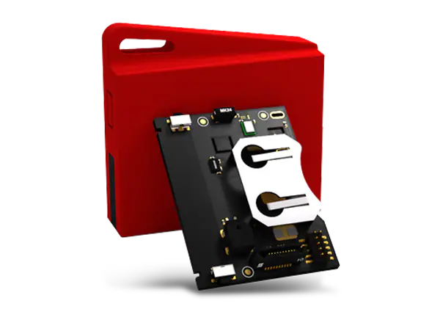
Device to be used for Assignment and Project
Sensor tag and Programmer: A wireless embedded device
Look for email for information regarding collection of sensortags
We can give 2-3 sensor tags per group
The sensor tags would allow us to conduct wireless experiments
Can run on a coin cell battery for weeks to months!
We will be use Contiki OS for programming sensor tag devices
Developed at SICS (Swedish Institute of Computer Science) now RI.SE

Slide 28
Tutorials
First two tutorials are already uploaded on the course webpage
Attendance to tutorials is graded (10% of overall grade)
Expectation: Read questions before coming to the session. Solve and ask doubts from the teaching assistants
Very important as you can expect questions in the final assessment to be very similar to the ones you will find in the tutorials
Tutorials: Begin Week3! Please attend tutorials in designated slots
Exception: can attend other slots, please ask TA’s to note down your details

Slide 29
Important Events and Deadlines
Event | Date
Lectures | Starting Week 1 (19th January)
Group formation and notification | End of Week 4
Tutorials | Begin Week 3 (29th January)
Assignment 1 | Demonstrate to TA’s Week 5
Assignment 2, 3 | TBA
Project submission | 26th April 2024 (EOD)
Final assessment | 29th April 2024

Slide 30
Course Topics and Lecture Schedule
Lecture Series | Date
Introduction | Starting January 19th
Basics | Starting January 26th
Energy Efficient Communication and Sustainability | Starting February 16th
Localization, Discovering Neighbors and Routing | Starting March 8th
Wide area, Opportunistic and Cellular Networks | Starting March 22nd
Commodity Wireless Standards (WiFi-ZigBee, Bluetooth) | Starting April 12th

Slide 31
Course Topics and Lecture Schedule
Wireless and Internet of Things Introduction
Basics of IoT devices and Wireless Communication
Wireless Propagation, Modulation, Estimating Communication Range
Basics of IoT Devices, Sensing, Actuation, Contiki Operating System
Battery Lifespan, Wireless Energy Challenge, Layers of Wireless Networking Stack

Slide 32
Break! Q&A (5 minutes)
Notes:
++ Over the past few years, I have designed several backscatter and beyond backscatter systems that precisely overcome these critical challenges that have limited the widespread deployment of backscatter on IoT devices.
++ The research vision that I have pursued and would like to pursue as a faculty member is to enable a massive deployment of IoT devices by bridging the energy asymmetry between sensing, computation and communication blocks by designing novel platforms and communication mechanisms. I am going to describe some of my research contributions next.

Slide 33
Roadmap of the lecture today
Let us get to know the instructor ☺
What is this course about? Logistics? Grading Criteria?
Introduction to Embedded Systems (aka IoT)
Mark Weiser Vision for Ubiquitous Computing
Basics of Wireless Communication and Signal Propagation
Notes:
Here is the roadmap of the major topics that I am going to cover during the presentation. We have already covered the exponential growth of the internet of things; next, I will talk about the critical energy challenge that can severely hinder this massive growth and preventing us from realising this immense economic value enabled by the IoT.

Slide 34
Do you know what the Internet of Things is? How does Internet of Things impact you?
Notes:
++ Over the past few years, I have designed several backscatter and beyond backscatter systems that precisely overcome these critical challenges that have limited the widespread deployment of backscatter on IoT devices.
++ The research vision that I have pursued and would like to pursue as a faculty member is to enable a massive deployment of IoT devices by bridging the energy asymmetry between sensing, computation and communication blocks by designing novel platforms and communication mechanisms. I am going to describe some of my research contributions next.

Slide 35
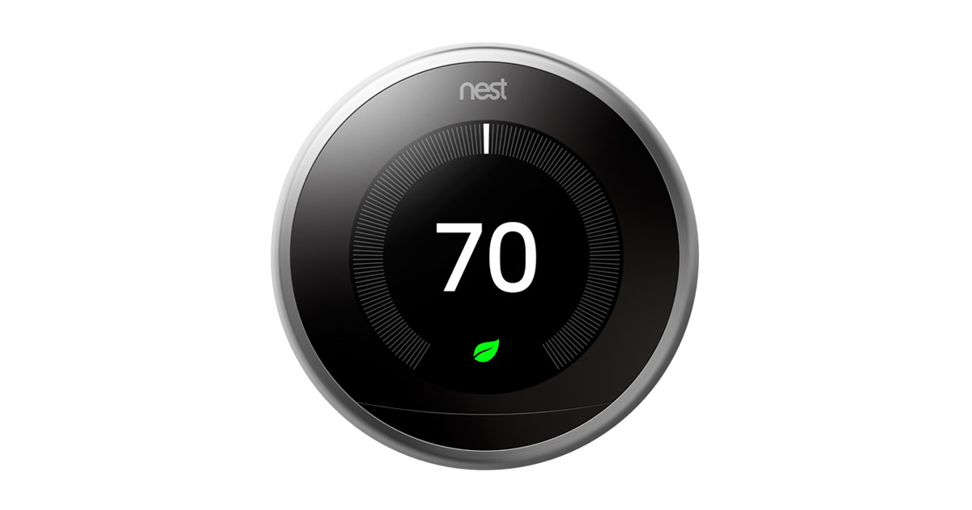
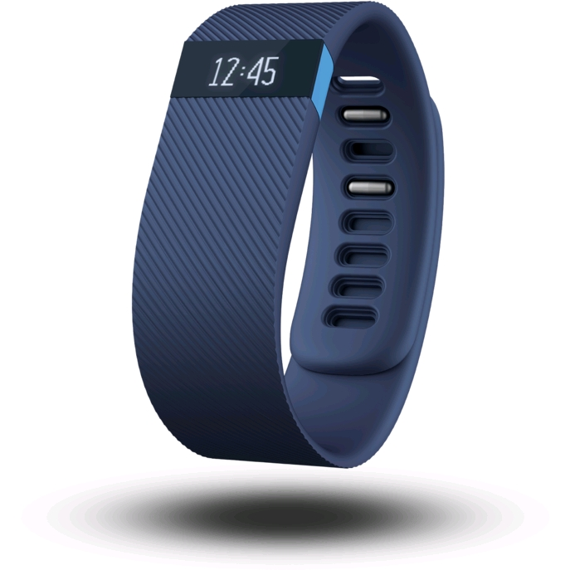
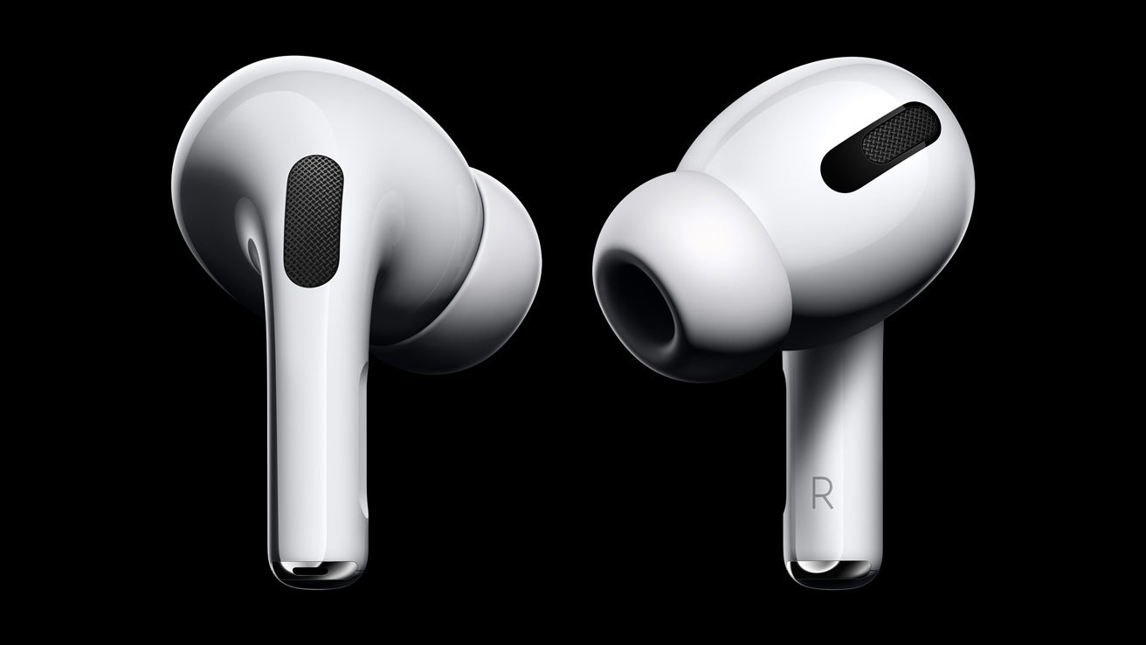
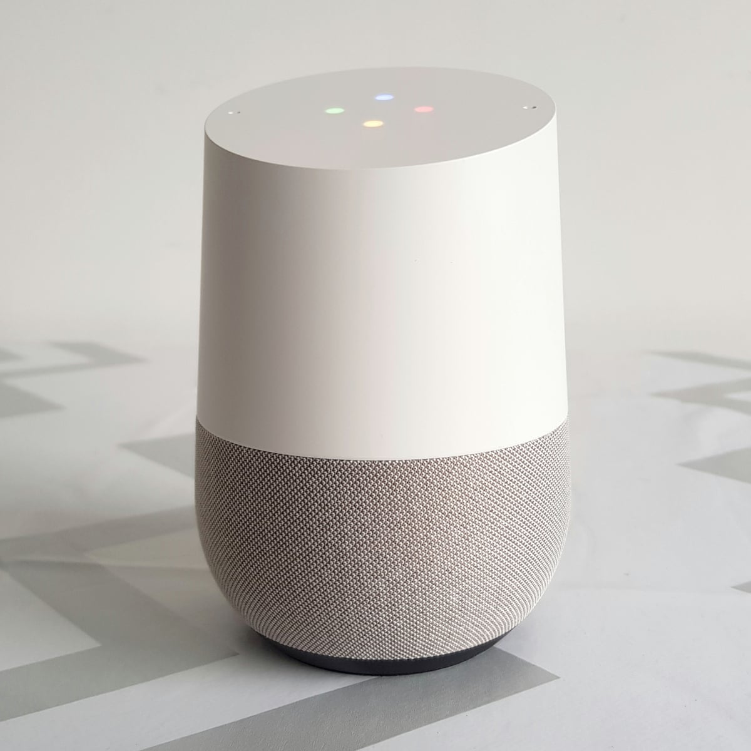
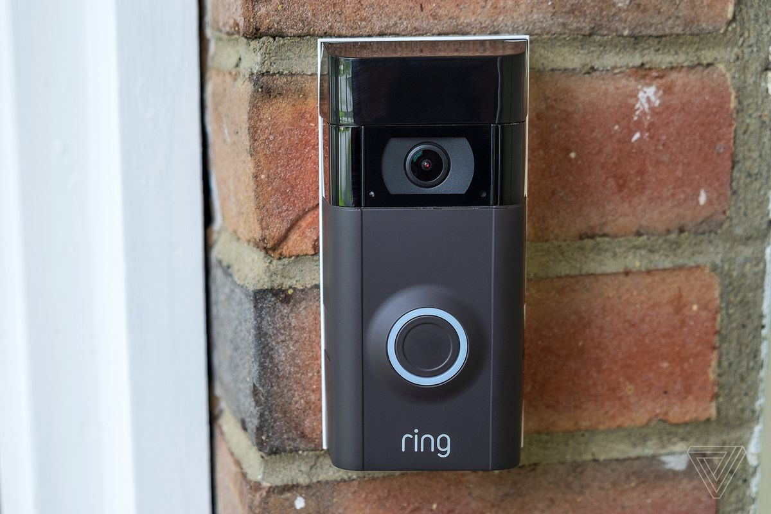
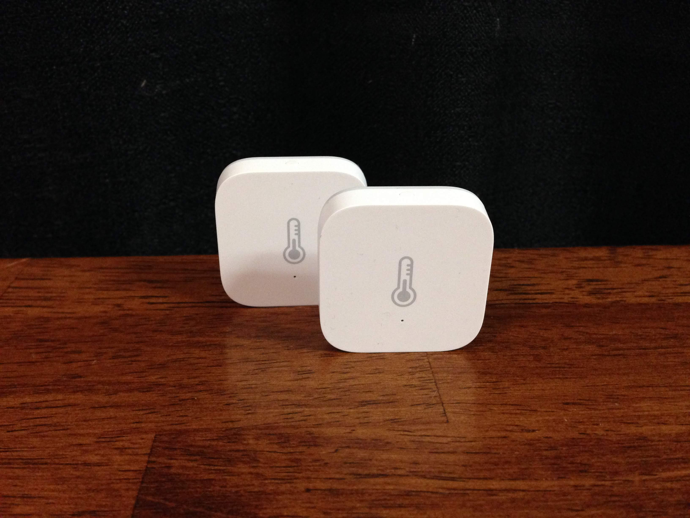
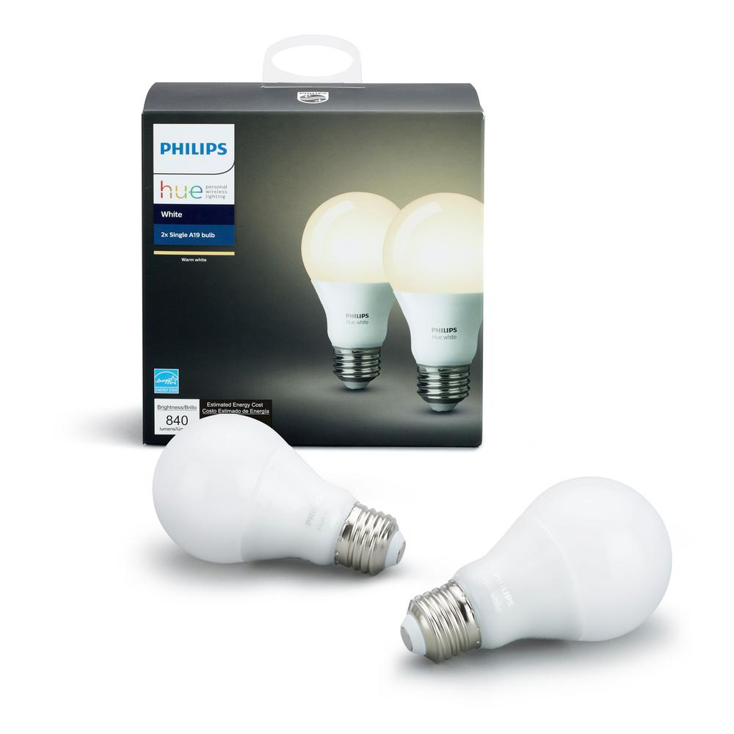
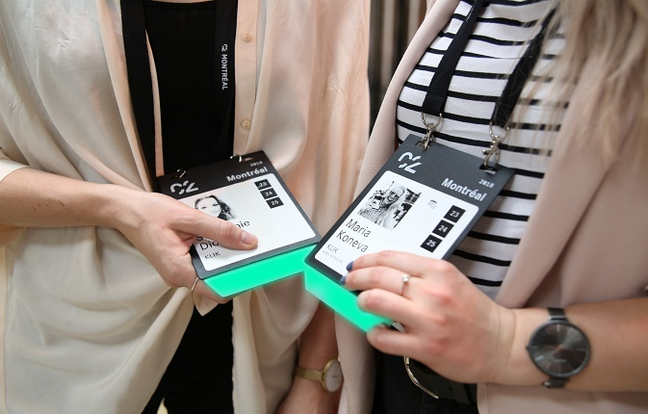
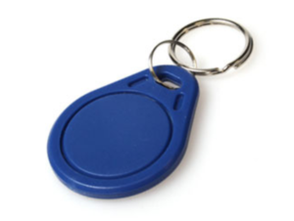
Internet of things devices are all around us...
Google nest thermostat
Fitbit activity tracker
Apple airpods
Smart speaker
Ring doorbell
Xiaomi temperature sensor
Philips hue smart bulb
Smart badges
BLE proximity beacon
Notes:
+ I begin this presentation by demonstrating devices that we interact with within our daily lives. These include Fitbit, AirPods, smart speakers or ble proximity beacons that we attach to objects such as keychain to keep track of them. All of these are examples of wireless embedded systems.

Slide 36
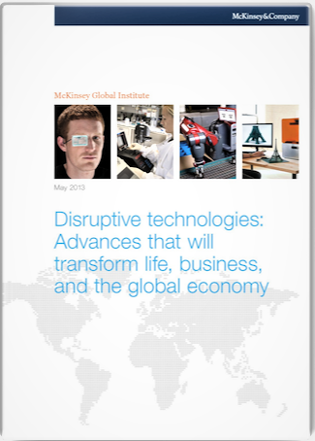
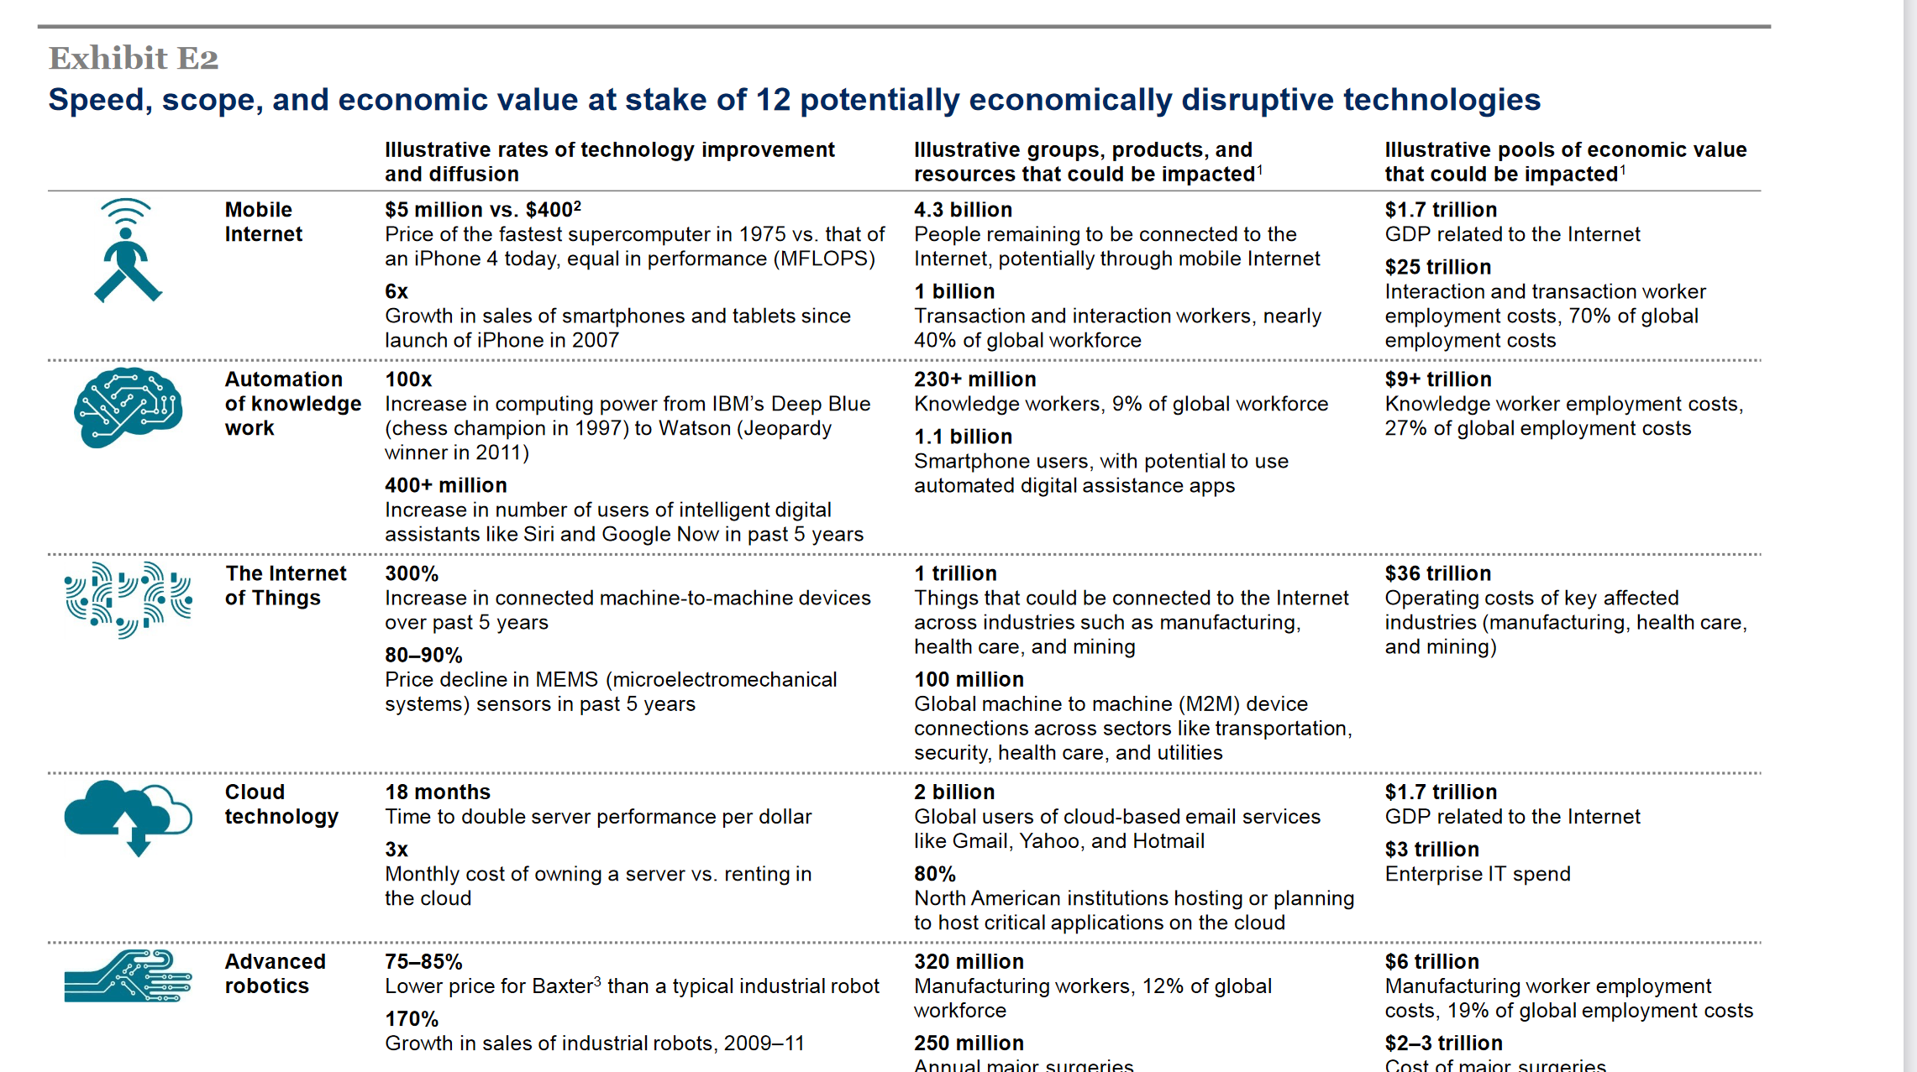
Internet of things will be bigger than cloud computing
Disruptive technologies: Advances that will transform life, business, and the global economy - McKinsey Global Institute (2013)
Notes:
So how big would the Internet of Things be?
We investigate a report from McKinsey called Disruptive Technologies which claims that the IoT would influence the combined economic value well over 36 trillion, far higher than cloud technology. Hence, this rapid growth in the IoT that we are witnessing is placing us on a pathway towards eclipsing (in economic value) major trends from previous decades, such as the cloud computing.

Slide 37
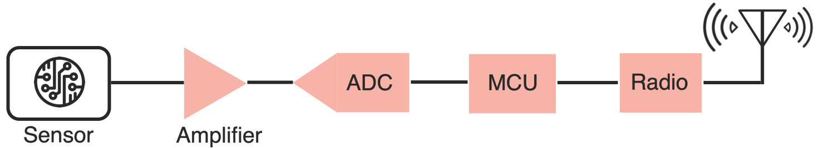
Wireless embedded devices architecture
During past decades, sensors have become exceedingly energy-efficient
E.g., Accelerometer, Temperature, Image Sensors: Few µW’s of power
Significant energy asymmetry exists between the sensors, computational elements and radio transceivers
Conventional and widely used architecture of embedded wireless platform
Notes:
Why do the IoT platforms suffer from this energy challenge? To understand this, we investigate the architecture of the IoT device. We show this architecture in the figure on the slide. It consists of a series of stages that enable us to sense physical phenomena, process and transmit the sensor information through a transceiver such as ZigBee/BLE/LoRa.
This architecture has remained unchanged over the past two decades. We find that during this time, sensors have become exceeding efficient. Today, we find sensors such as an accelerometer or a temperature sensor consumes just a few tens of microwatts of power consumption. However, we find that rest of the architecture components that are shown in red colour remain significantly energy expensive. To understand the reason for this significant energy asymmetry, we look at the following slide.

Slide 38
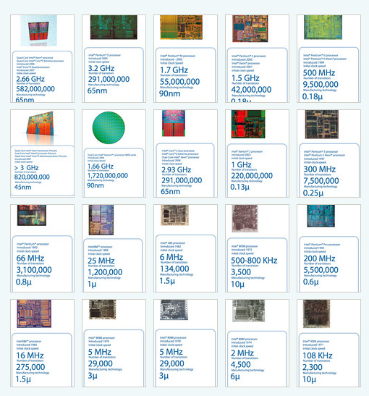
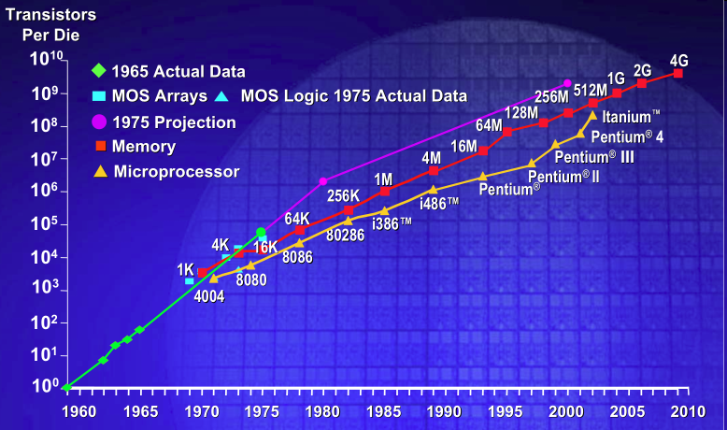
IC transistor count doubles every two years
Photo Credit: Intel
Notes:
So if we look at the computing spectrum today, each of the classes exist simultaneously. In a room we can put 100s of teraflops and many petabytes of computing.
Our productivity, document preparation, and personal information management fits in our pocket and a new class is emerging that will provide a means of streaming information to and from the physical world like we have never seen before.

Slide 39
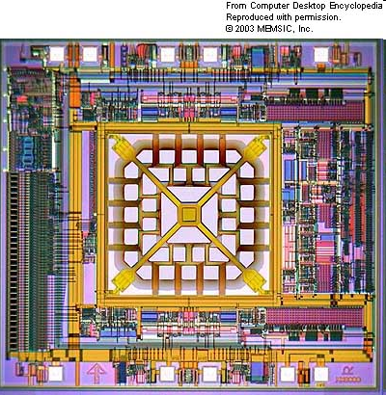
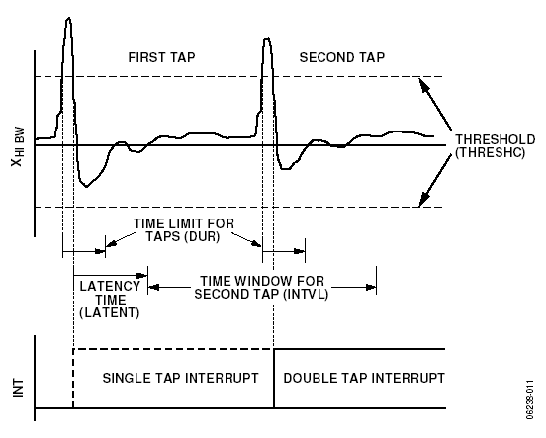
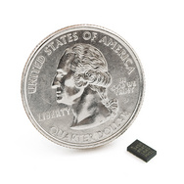
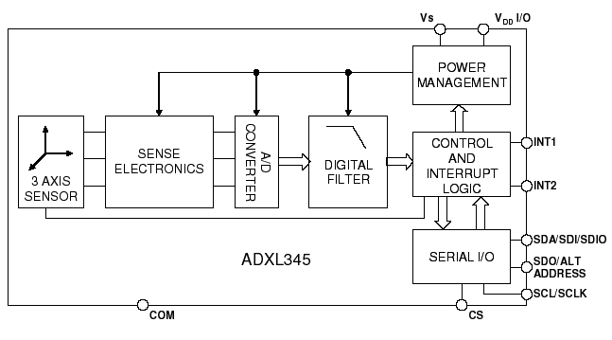
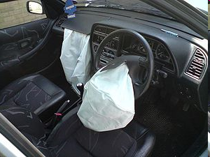
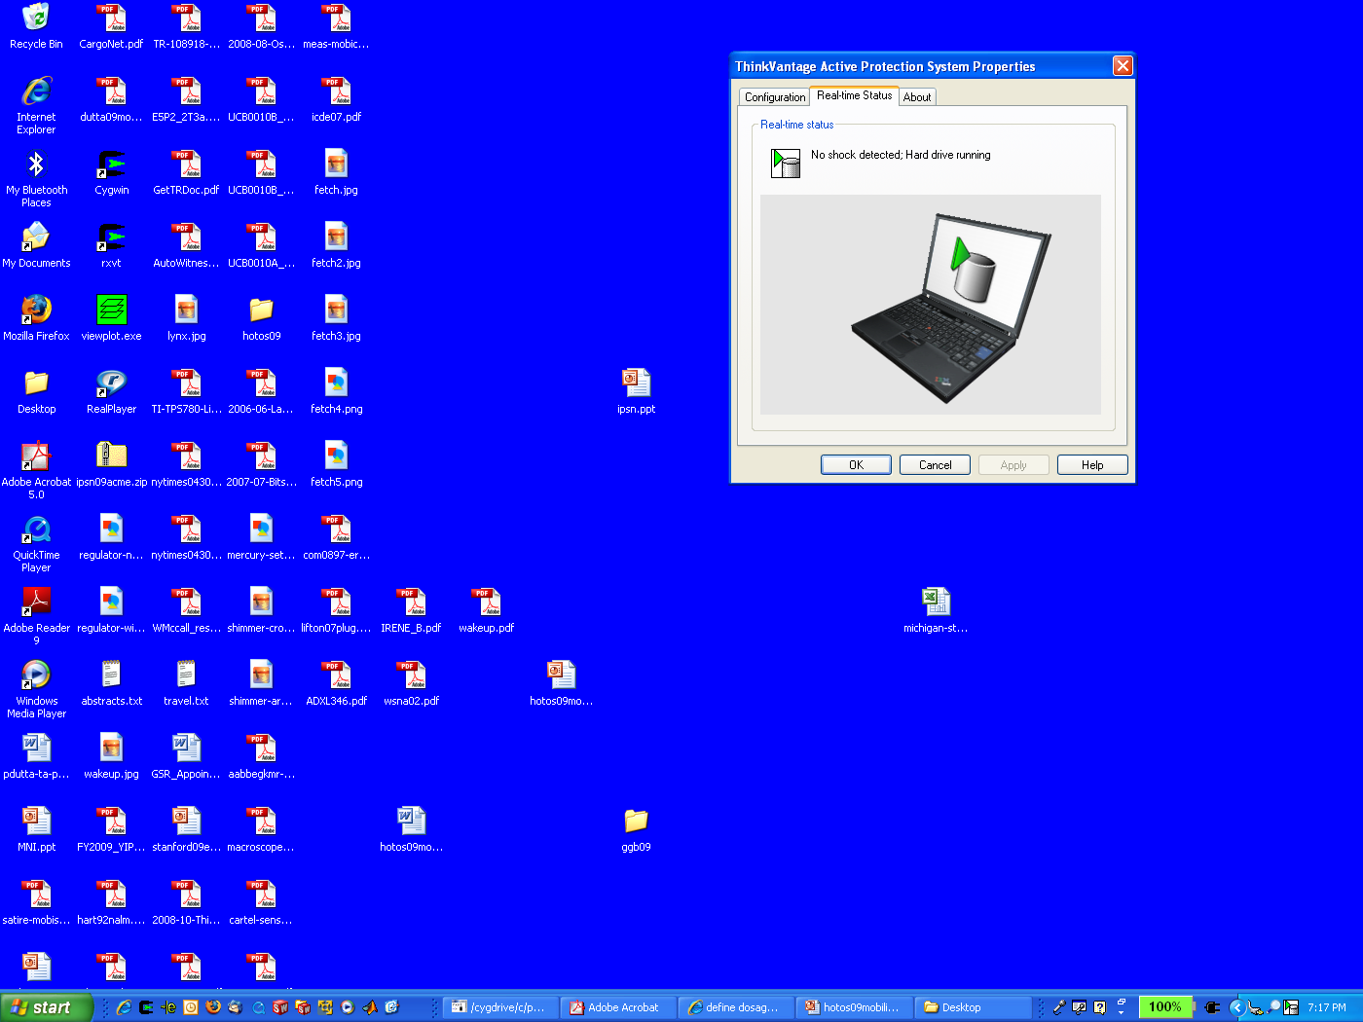
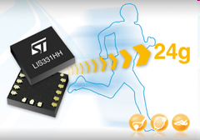
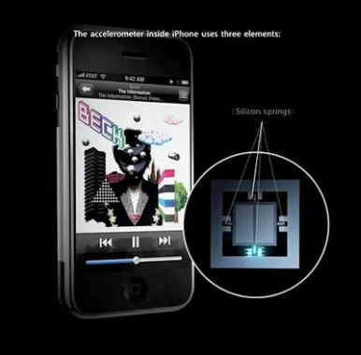
MEMS Accelerometers: Rapidly falling price and power
O(mA)
Price
Power
25 µA @ 25 Hz
ADXL345
[Analog Devices, 2009]
10 µA @ 10 Hz @ 6 bits
[ST Microelectronics, annc. 2009]

Slide 40
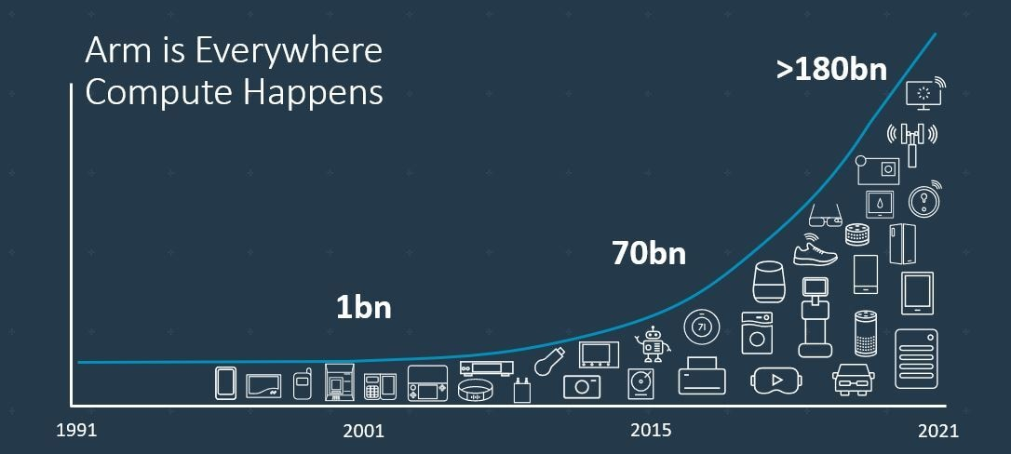
Trillion embedded devices will be deployed soon
Fourth quarter of 2020. Arm shipped 4.4 billion Cortex-M processors
ARM Press Release (Feb 11, 2021) reporting on Fourth Quarter 2020
Notes:
++ Due to the numerous applications that the internet of things enables, we are witnessing a massive growth in the number of microcontrollers being sold. These microcontrollers form the heart of the IoT platforms.
++ To illustrate this point: ARM, a popular UK based company, just reported numbers, and in these numbers, they state that they sold 4.4 billion cortex M processors in just one quarter. These microcontrollers are almost exclusively used on IoT platforms, which demonstrates the massive growth we are witnessing in the number of deployed IoT devices.
++ If this growth continues, and in fact, I believe this growth will accelerate, we will soon have a trillion embedded devices that are going to be deployed in the world.

Slide 41
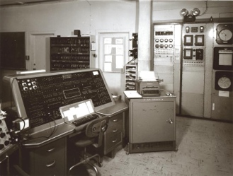






Trillion embedded devices will be deployed soon
Mainframe
“Roughly every decade a new, lower priced computer class forms based on a new programming platform, network, and interface resulting in new usage and the establishment of a new industry.”
1 per Enterprise
Workstation
1 per Engineer
[Bell et al. Computer, 1972, ACM, 2008]
Smart Dust
Laptop
100 – 1000’s per person
log (people per computer)
1 per Professional
IoT/Wearable
Mini Computer
10’s per person
1 per Company
Personal Computer
1 per Family
Smartphone
1 per person

Slide 42



Where are we right now?

Slide 43


Word of caution: Mind the hype

Slide 44
Mark Weiser Vision for Ubiquitious Computing
Notes:
++ Over the past few years, I have designed several backscatter and beyond backscatter systems that precisely overcome these critical challenges that have limited the widespread deployment of backscatter on IoT devices.
++ The research vision that I have pursued and would like to pursue as a faculty member is to enable a massive deployment of IoT devices by bridging the energy asymmetry between sensing, computation and communication blocks by designing novel platforms and communication mechanisms. I am going to describe some of my research contributions next.

Slide 45

Mark Weiser vision of ubiquitous computing
Mark Weiser (1952 – 1999)
PhD (University of Michigan), CTO at Xerox PARC
Considered “Father” of ubiquitous computing
He is a highly influential figure in the area
What is ubiquitous computing?

Slide 46
Mark Weiser vision of ubiquitous computing
“Ubiquitous computing names the third wave in computing, just now beginning. First were mainframes, each shared by lots of people. Now we are in the personal computing era, person and machine staring uneasily at each other across the desktop. Next comes ubiquitous computing, or the age of calm technology, when technology recedes into the background of our lives.”

Slide 47
Mark Weiser vision of ubiquitous computing
“The most profound technologies are those that disappear”
”Products…that do not require active attention”
“Whenever people learn something sufficiently well, they cease to be aware of it”
“[Computers will become invisible and] people will simply use them unconsciously to accomplish everyday tasks”
“[R]ather than being a tool through which we work, and thus disappearing from our awareness, the computer too often remains the focus of attention”
“Applications are of course the whole point of ubiquitous computing”

Slide 48

Mark Weiser vision of ubiquitous computing
“The most profound technologies are those that disappear”
Do you agree? What are technologies we now take for granted?
Wearable devices (< 15 years), Smartphones, Smarthome sensors

Slide 49


Mark Weiser vision of ubiquitous computing
What are upcoming technologies that may become ubiquitous?

Slide 50

Mark Weiser vision of ubiquitous computing
The Computer for the 21st Century, Scientific American, 1991

Slide 51
Mark Weiser vision of ubiquitous computing
Hypothesis of the article: Advances in technology (low power, new wireless communication, new interfaces) will enable “invisible computing”, which will enhance human capability …

Slide 52









Four main tasks performed by an embedded device
Computation and Storage
Sensing and Actuation
Power
Management
Wireless Networking
Notes:
First, we look at the computational elements, and these consist of a microcontroller or an FPGA. Today, we find that these computational elements consume at least one order of magnitude higher power consumption when compared to the commonly used sensors.
However, we also find that microcontrollers are increasingly becoming energy efficient. We investigate a typical microcontroller that has been used in sensor platforms over the past two decades. We find that energy efficiency has improved by almost two orders of magnitude. Some of the present-generation microcontrollers, such as Ambiq Apollo4 consume just 3 uA/MHz than 330 uA for MSP430 used on platforms such as TelOS B.
If the trend continues, we can expect the microcontrollers to catch up with the sensors and become energy-efficient. This significant improvement is that the digital components are increasing becoming efficient as they follow moore’s law.

Slide 53
Four main tasks performed by an embedded device
Computation and Storage
Sensing and Actuation
Power
Management
Wireless Networking
Notes:
First, we look at the computational elements, and these consist of a microcontroller or an FPGA. Today, we find that these computational elements consume at least one order of magnitude higher power consumption when compared to the commonly used sensors.
However, we also find that microcontrollers are increasingly becoming energy efficient. We investigate a typical microcontroller that has been used in sensor platforms over the past two decades. We find that energy efficiency has improved by almost two orders of magnitude. Some of the present-generation microcontrollers, such as Ambiq Apollo4 consume just 3 uA/MHz than 330 uA for MSP430 used on platforms such as TelOS B.
If the trend continues, we can expect the microcontrollers to catch up with the sensors and become energy-efficient. This significant improvement is that the digital components are increasing becoming efficient as they follow moore’s law.

Slide 54
Break! (5 minutes)
Notes:
++ Over the past few years, I have designed several backscatter and beyond backscatter systems that precisely overcome these critical challenges that have limited the widespread deployment of backscatter on IoT devices.
++ The research vision that I have pursued and would like to pursue as a faculty member is to enable a massive deployment of IoT devices by bridging the energy asymmetry between sensing, computation and communication blocks by designing novel platforms and communication mechanisms. I am going to describe some of my research contributions next.

Slide 55
Roadmap of the lecture today
Let us get to know the instructor ☺
What is this course about? Logistics? Grading Criteria?
Introduction to Embedded Systems (aka IoT)
Mark Weiser Vision for Ubiquitous Computing
Basics of Wireless Communication and Signal Propagation
Notes:
Here is the roadmap of the major topics that I am going to cover during the presentation. We have already covered the exponential growth of the internet of things; next, I will talk about the critical energy challenge that can severely hinder this massive growth and preventing us from realising this immense economic value enabled by the IoT.

Slide 56
History and Growth of Wireless Communication
Notes:
++ Over the past few years, I have designed several backscatter and beyond backscatter systems that precisely overcome these critical challenges that have limited the widespread deployment of backscatter on IoT devices.
++ The research vision that I have pursued and would like to pursue as a faculty member is to enable a massive deployment of IoT devices by bridging the energy asymmetry between sensing, computation and communication blocks by designing novel platforms and communication mechanisms. I am going to describe some of my research contributions next.

Slide 57



History of Wireless Transmissions
First to demonstrate wireless communication ?
1880: Alexander Graham Bell and his assistant Charles Sumner Tainter at the Bell Labs invented the photophone
Photophone: a device that transmitted sound on a beam of light
Notes:
First, we look at the computational elements, and these consist of a microcontroller or an FPGA. Today, we find that these computational elements consume at least one order of magnitude higher power consumption when compared to the commonly used sensors.
However, we also find that microcontrollers are increasingly becoming energy efficient. We investigate a typical microcontroller that has been used in sensor platforms over the past two decades. We find that energy efficiency has improved by almost two orders of magnitude. Some of the present-generation microcontrollers, such as Ambiq Apollo4 consume just 3 uA/MHz than 330 uA for MSP430 used on platforms such as TelOS B.
If the trend continues, we can expect the microcontrollers to catch up with the sensors and become energy-efficient. This significant improvement is that the digital components are increasing becoming efficient as they follow moore’s law.

Slide 58


History of Wireless Transmissions
First to demonstrate wireless communication ?
1893: Nikola Tesla gave a public demonstration of "wireless" radio communication at St. Louis, Missouri, USA
Notes:
First, we look at the computational elements, and these consist of a microcontroller or an FPGA. Today, we find that these computational elements consume at least one order of magnitude higher power consumption when compared to the commonly used sensors.
However, we also find that microcontrollers are increasingly becoming energy efficient. We investigate a typical microcontroller that has been used in sensor platforms over the past two decades. We find that energy efficiency has improved by almost two orders of magnitude. Some of the present-generation microcontrollers, such as Ambiq Apollo4 consume just 3 uA/MHz than 330 uA for MSP430 used on platforms such as TelOS B.
If the trend continues, we can expect the microcontrollers to catch up with the sensors and become energy-efficient. This significant improvement is that the digital components are increasing becoming efficient as they follow moore’s law.

Slide 59



History of Wireless Transmissions
First to demonstrate wireless communication ?
1896: Guglielmo Marconi's first radio transmissions, coded signals that were transmitted only about 1.6 km (a mile)
1899: Marconi sends a signal over the English Channel ~50km
Notes:
First, we look at the computational elements, and these consist of a microcontroller or an FPGA. Today, we find that these computational elements consume at least one order of magnitude higher power consumption when compared to the commonly used sensors.
However, we also find that microcontrollers are increasingly becoming energy efficient. We investigate a typical microcontroller that has been used in sensor platforms over the past two decades. We find that energy efficiency has improved by almost two orders of magnitude. Some of the present-generation microcontrollers, such as Ambiq Apollo4 consume just 3 uA/MHz than 330 uA for MSP430 used on platforms such as TelOS B.
If the trend continues, we can expect the microcontrollers to catch up with the sensors and become energy-efficient. This significant improvement is that the digital components are increasing becoming efficient as they follow moore’s law.

Slide 60

Early milestones for wireless communication
1901: Trans-atlantic transmission England to America (>3000km)

Slide 61



Early milestones for wireless communication
1906: (AM radio) first audio broadcast of music/voice from shore to ship
1912: The RMS Titanic sank. After this, wireless telegraphy quickly became universal on large ships for communication
1915: AT&T sent speech from Arlington (Virginia) to Paris (>6,000km)

Slide 62

History of Audio/Video broadcasting
1916: Regular broadcast of weather information using Morse code
1917 - 1919: Clear transmission of music, voice and human speech
Early Radio Stations
1922: France, UK
1936: Malaya, Singapore
1935: Frequency modulation (FM) demonstrated by Armstrong
1980s: Digital Audio Broadcasting (DAB)

Slide 63

History of Television Broadcasting
1923: First wireless TV transmission
1941: NTSC (National Television System Committee), 525 lines per inch at 30 fps in a bandwidth of 6 MHz
1962: AT&T launches Telstar, the first satellite to carry TV broadcasts
1963: PAL or Phase Alternating Line standardized, uses 625 lines
1963: First TV broadcast in Singapore (channel 5)‏
1996: US. HDTV standardized

Slide 64
History of Voice and Cellular Communication
1946 - First interconnection of mobile users to public switched telephone network (PSTN), “zero” generation
1983 - Advanced Mobile Phone System (AMPS) deployed in US in 900 MHz
1989 - Groupe Spècial Mobile defines European digital cellular standard, GSM
1993 - IS-95 code-division multiple-access (CDMA) digital cellular system deployed in US

Slide 65


WiFi standard timeline
1985 – US FCC rules ISM band for unlicensed use
1990s – WaveLAN (NCR Corporation, Netherlands)
Wireless ethernet for cashier systems
1997 – 802.11 specification
1999 – 802.11b and 802.11a amendments
1999 – WiFi Alliance formed for certification of devices
1999 – Apple iBook is the first consumer WiFi product
Notes:
++ While we are deploying an enormously large number of IoT devices, I claim that very little attention is being paid to their energy challenge.
++ Today, most IoT devices are very energy expensive, and consequently, they rely on bulky batteries such as AA/AAA sized batteries for their operation. Even when operating on these batteries, they require frequent replacement of the exhausted batteries. This can be challenging when performed at a massive scale, especially considering that we may have a trillion embedded device deployed in the world.
++ Further, it can also harm the environment. These batteries use toxic chemicals, which means now we can have billions of toxic chemicals laden batteries that would be disposed of in landfills. This is especially important as sustainability has become an essential aspect across the world; in fact, imperial college was celebrating sustainability week.

Slide 66
iBook (1999)
First consumer laptop to support wireless (WiFi) capability

Slide 67
Basics of Wireless Communication
Notes:
++ Over the past few years, I have designed several backscatter and beyond backscatter systems that precisely overcome these critical challenges that have limited the widespread deployment of backscatter on IoT devices.
++ The research vision that I have pursued and would like to pursue as a faculty member is to enable a massive deployment of IoT devices by bridging the energy asymmetry between sensing, computation and communication blocks by designing novel platforms and communication mechanisms. I am going to describe some of my research contributions next.

Slide 68
What are wireless radios?
Radios are electronic devices that enables wireless transmission of signals
Electromagnetic signal is modulated and radiated out of the antenna
Wireless transmissions are then received by a receiver radio device
Antenna
Radio frequency signal
Radio transmitter
Radio receiver
Notes:
First, we look at the computational elements, and these consist of a microcontroller or an FPGA. Today, we find that these computational elements consume at least one order of magnitude higher power consumption when compared to the commonly used sensors.
However, we also find that microcontrollers are increasingly becoming energy efficient. We investigate a typical microcontroller that has been used in sensor platforms over the past two decades. We find that energy efficiency has improved by almost two orders of magnitude. Some of the present-generation microcontrollers, such as Ambiq Apollo4 consume just 3 uA/MHz than 330 uA for MSP430 used on platforms such as TelOS B.
If the trend continues, we can expect the microcontrollers to catch up with the sensors and become energy-efficient. This significant improvement is that the digital components are increasing becoming efficient as they follow moore’s law.

Slide 69
We need to understand several terms and concepts
What are electromagnetic waves?
How are these electromagnetic waves modulated?
How are they radiated from the transmitter to receiver?
How do these signals propagate? How far can we receive these signals?
What are different wireless standards ?
Antenna
Radio frequency signal
Radio transmitter
Radio receiver
Notes:
First, we look at the computational elements, and these consist of a microcontroller or an FPGA. Today, we find that these computational elements consume at least one order of magnitude higher power consumption when compared to the commonly used sensors.
However, we also find that microcontrollers are increasingly becoming energy efficient. We investigate a typical microcontroller that has been used in sensor platforms over the past two decades. We find that energy efficiency has improved by almost two orders of magnitude. Some of the present-generation microcontrollers, such as Ambiq Apollo4 consume just 3 uA/MHz than 330 uA for MSP430 used on platforms such as TelOS B.
If the trend continues, we can expect the microcontrollers to catch up with the sensors and become energy-efficient. This significant improvement is that the digital components are increasing becoming efficient as they follow moore’s law.

Slide 70


Electromagnetic waves and spectrum
Electromagnetic waves are synchronized oscillations of electric and magnetic field. There is a periodic change of electric and magnetic field
How often this periodic change occurs dictates the property
Notes:
First, we look at the computational elements, and these consist of a microcontroller or an FPGA. Today, we find that these computational elements consume at least one order of magnitude higher power consumption when compared to the commonly used sensors.
However, we also find that microcontrollers are increasingly becoming energy efficient. We investigate a typical microcontroller that has been used in sensor platforms over the past two decades. We find that energy efficiency has improved by almost two orders of magnitude. Some of the present-generation microcontrollers, such as Ambiq Apollo4 consume just 3 uA/MHz than 330 uA for MSP430 used on platforms such as TelOS B.
If the trend continues, we can expect the microcontrollers to catch up with the sensors and become energy-efficient. This significant improvement is that the digital components are increasing becoming efficient as they follow moore’s law.

Slide 71

Radio waves are most important part of electromagnetic spectrum
Most (if not all) modern communication relies on radio waves
Frequency range: 30 Hz to 300 GHz
It has the longest wavelength among EM
Notes:
First, we look at the computational elements, and these consist of a microcontroller or an FPGA. Today, we find that these computational elements consume at least one order of magnitude higher power consumption when compared to the commonly used sensors.
However, we also find that microcontrollers are increasingly becoming energy efficient. We investigate a typical microcontroller that has been used in sensor platforms over the past two decades. We find that energy efficiency has improved by almost two orders of magnitude. Some of the present-generation microcontrollers, such as Ambiq Apollo4 consume just 3 uA/MHz than 330 uA for MSP430 used on platforms such as TelOS B.
If the trend continues, we can expect the microcontrollers to catch up with the sensors and become energy-efficient. This significant improvement is that the digital components are increasing becoming efficient as they follow moore’s law.

Slide 72

Commodity wireless operates in the unlicensed band (ISM band)
902 MHz – 928 MHz
LPWANs
2.4 GHz to 2.5 GHz
WiFi, BLE, Thread
5 GHz
Faster WiFi

Slide 73

How are electromagnetic radio waves characterized ?
Signal strength
The amount of energy transmitted/received
Signal frequency and bandwidth
Which “channel” the signal is sent on
Signal modulation
How data is encoded in the signal
Notes:
First, we look at the computational elements, and these consist of a microcontroller or an FPGA. Today, we find that these computational elements consume at least one order of magnitude higher power consumption when compared to the commonly used sensors.
However, we also find that microcontrollers are increasingly becoming energy efficient. We investigate a typical microcontroller that has been used in sensor platforms over the past two decades. We find that energy efficiency has improved by almost two orders of magnitude. Some of the present-generation microcontrollers, such as Ambiq Apollo4 consume just 3 uA/MHz than 330 uA for MSP430 used on platforms such as TelOS B.
If the trend continues, we can expect the microcontrollers to catch up with the sensors and become energy-efficient. This significant improvement is that the digital components are increasing becoming efficient as they follow moore’s law.

Slide 74

How are radio waves modulated with information
Encoding information “baseband" in an analog “carrier” signal
Baseband signal often much lower frequency than carrier
Carrier signal defines the frequency/part of spectrum
Notes:
First, we look at the computational elements, and these consist of a microcontroller or an FPGA. Today, we find that these computational elements consume at least one order of magnitude higher power consumption when compared to the commonly used sensors.
However, we also find that microcontrollers are increasingly becoming energy efficient. We investigate a typical microcontroller that has been used in sensor platforms over the past two decades. We find that energy efficiency has improved by almost two orders of magnitude. Some of the present-generation microcontrollers, such as Ambiq Apollo4 consume just 3 uA/MHz than 330 uA for MSP430 used on platforms such as TelOS B.
If the trend continues, we can expect the microcontrollers to catch up with the sensors and become energy-efficient. This significant improvement is that the digital components are increasing becoming efficient as they follow moore’s law.

Slide 75

How are radio waves sent from transmitter to receiver
Antenna: An electrical conductor or system of conductor
Transmission: radio frequency electrical energy converted into electromagnetic energy
Reception: the reverse occurs, electromagnetic energy converted into electrical energy
Two-way communication, the same antenna used for transmission and reception
Primarily we have two radiation patterns: omni-directional, directional

Slide 76


Common antenna types used for wireless communication
Dipole antenna: A simple antenna consisting of wires pointed in opposite directions arranged either horizontally or vertically, with end of each wire connected to the radio and the other end is hanging in the free space
Half-wave dipole: A more efficient variation of dipole antenna is the half-wave dipole antenna, which radiates energy efficiently when the wavelength of radio signal is twice the electrical length of the antenna

Slide 77




Common antenna types used for wireless communication
Monopole: A straight wire mounted on conductive surface (ground plane)
Array: A set of connected antenna elements working together
Loop: A loop or wire or a conductor that acts like an antenna
Aperture: Transmits/receives electromagnetic wave through a hole
….. (and even more exists) …..

Slide 78
How do we characterize wireless networks/standards
Four parameters help to characterize wireless networks:
Communication Range
Data Rate
Power
Frequency Band

Slide 79
Wireless standards classified on basis of throughput
1 Gbps
802.11ac
4G
802.11n
High Rate UWB
100 Mbps
10 Mbps
1 Mbps
Bluetooth
BLE/802.15.4
100 kbps
LoRA
UWB (802.15.4-2011)
NFC
10 kbps
1GHz
2GHz
3GHz
4GHz
5GHz
6GHz

Slide 80
Wireless standards classified on basis of range
10km
LoRA
4G
1km
100m
802.11n
BLE/802.15.4
UWB (802.15.4-2011)
Bluetooth
802.11ac
10m
1m
NFC
High Rate UWB
1GHz
2GHz
3GHz
4GHz
5GHz
6GHz

Slide 81
Wireless standards classified on the basis of power
10W
4G
1W
802.11n
802.11ac
UWB
100mW
LoRA
Bluetooth
BLE/802.15.4
NFC (Reader)
10mW
1mW
1GHz
2GHz
3GHz
4GHz
5GHz
6GHz

Slide 82

Communication remains a significant challenge
Performing communication remains orders of magnitude more energy expensive than performing sensing and computation
No scaling in power consumption due to Moore’s law. Energy expensive
Component | Power Consumption
Microcontroller (Apollo3) | 100s of µW’s (48 to 192 MHz)
Sensors | Few to tens of µW’s
Transceiver | Tens to Hundreds of mW’s
Power scaled with Moore’s law O(10 uW)
No such scaling O(100 mW)
Digital
(Baseband)
Analog
(RF)
Notes:
++ Due to the following of Moore’s law, we find that the microcontrollers are bridging the gap between sensing and computation. However, we find that communication remains a challenge and the most expensive IoT platforms' operation. Today the transceivers employed to perform communication consumes orders of magnitude higher energy when compared to performing sensing and processing operation.
++ Why are the communication blocks not witnessing such a dramatic decrease in power consumption? To understand this, we investigate the high-level diagram of the communication block. It consists of digital baseband generation circuitry and an analog front end. Due to the following of Moore’s law, digital baseband circuitry is becoming energy efficient. However, we do not witness any such scaling for the analog components. This causes these analog blocks to remain extremely energy expensive, pushing the power consumption for performing transmissions to be tens to hundreds of milliwatts. As an example, radio transceivers such as LoRa consume hundreds of milliwatts of power consumption. This is precisely the reason that present day IoT platforms operate with limited lifetime even on bulky and energy dense batteries.

Slide 83
Why is the task of performing wireless communication energy expensive? How do we enable battery-free wireless devices that don’t harm the environment?
Notes:
++ Over the past few years, I have designed several backscatter and beyond backscatter systems that precisely overcome these critical challenges that have limited the widespread deployment of backscatter on IoT devices.
++ The research vision that I have pursued and would like to pursue as a faculty member is to enable a massive deployment of IoT devices by bridging the energy asymmetry between sensing, computation and communication blocks by designing novel platforms and communication mechanisms. I am going to describe some of my research contributions next.

Slide 84
Roadmap of the lecture today
Let us get to know the instructor ☺
What is this course about? Logistics? Grading Criteria?
Introduction to Embedded Systems (aka IoT)
Mark Weiser Vision for Ubiquitous Computing
Basics of Wireless Communication and Signal Propagation
Notes:
Here is the roadmap of the major topics that I am going to cover during the presentation. We have already covered the exponential growth of the internet of things; next, I will talk about the critical energy challenge that can severely hinder this massive growth and preventing us from realising this immense economic value enabled by the IoT.

Slide 85
Todos and next week
Review today’s lecture and the upcoming tutorial
Start discussions regarding formation of group for assignments/projects
Next week: We cover the Basics Wireless Propagation , Modulation, Estimating Communication Range
Notes:
++ We may all have heard of the term Internet of Things. So how are these wireless embedded systems related to the Internet of Things: Today, IoT includes a broad class of devices, including powerful platforms such as smartphones. However, it also includes more resource-constrained devices and what we call Wireless Embedded Systems, and in fact, I consider it to be one of the essential parts of the IoT ecosystem.
++ These are platforms equipped with a radio transceiver, sensor, microcontroller, and some form of energy storage. These platforms also often form a network, and sensor network as it is called has been an active area of research for the past two decades.
++ The research community has also developed wireless embedded platforms which we may know about, and these include: CMUCAM, which is an image sensor platform developed at Carnegie Mellon University, or Permamote is long life sensor platform from the lab I am associated with at UC Berkeley or Lorea which is a long-range backscatter platform that I had developed as part of my doctoral dissertation at Uppsala University. All of these are an example of Wireless Embedded Systems.

Slide 86
Wireless Networking
Ambuj Varshney
ambujv@nus.edu.sg
Notes:
++ Thank you for inviting me to give this talk
++ In this talk, I will present a pathway that can enable us to make wireless embedded systems ubiquitous. I will describe my previous research efforts that tackle the critical challenges that limit the growth of wireless embedded systems. These are related to the growing energy asymmetry that exists between sensing, computation and communication blocks on these platforms.
++ Finally, I will conclude my talk by covering the research agenda that I would like to work on as a faculty member.

